Slide 1
Methods: A Deeper Look
Chapter 7 of Visual C# How to Program, 6/e

Slide 2
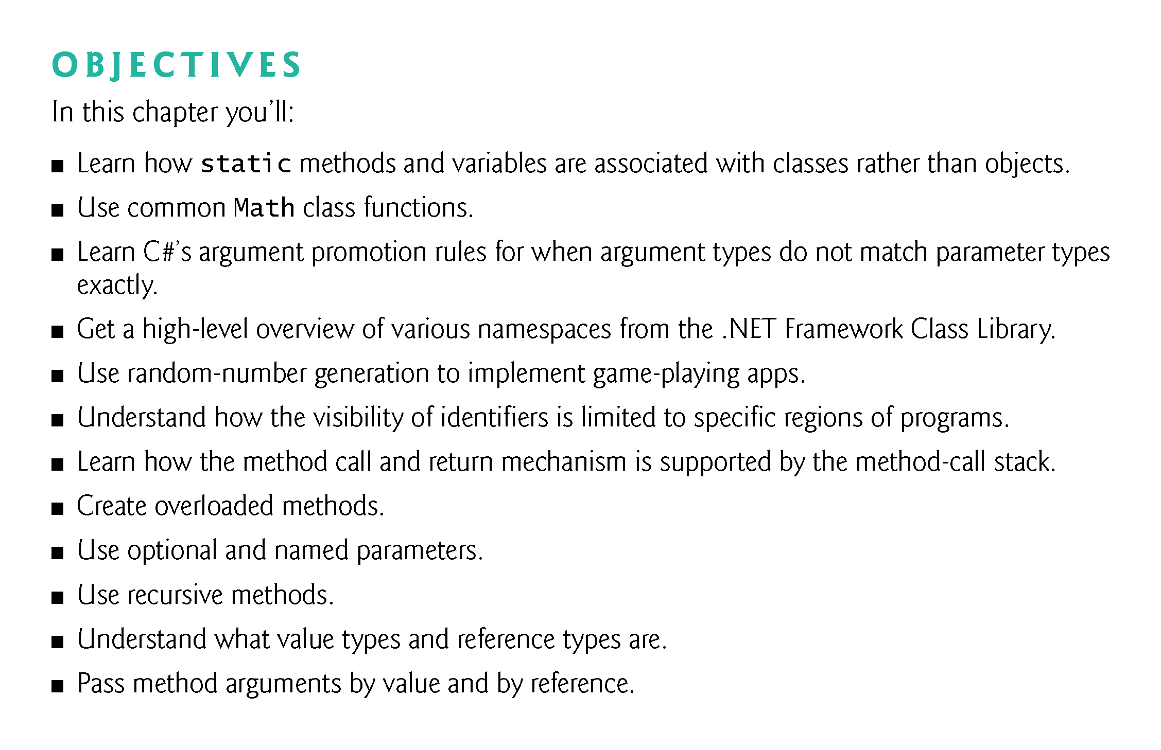

Slide 3
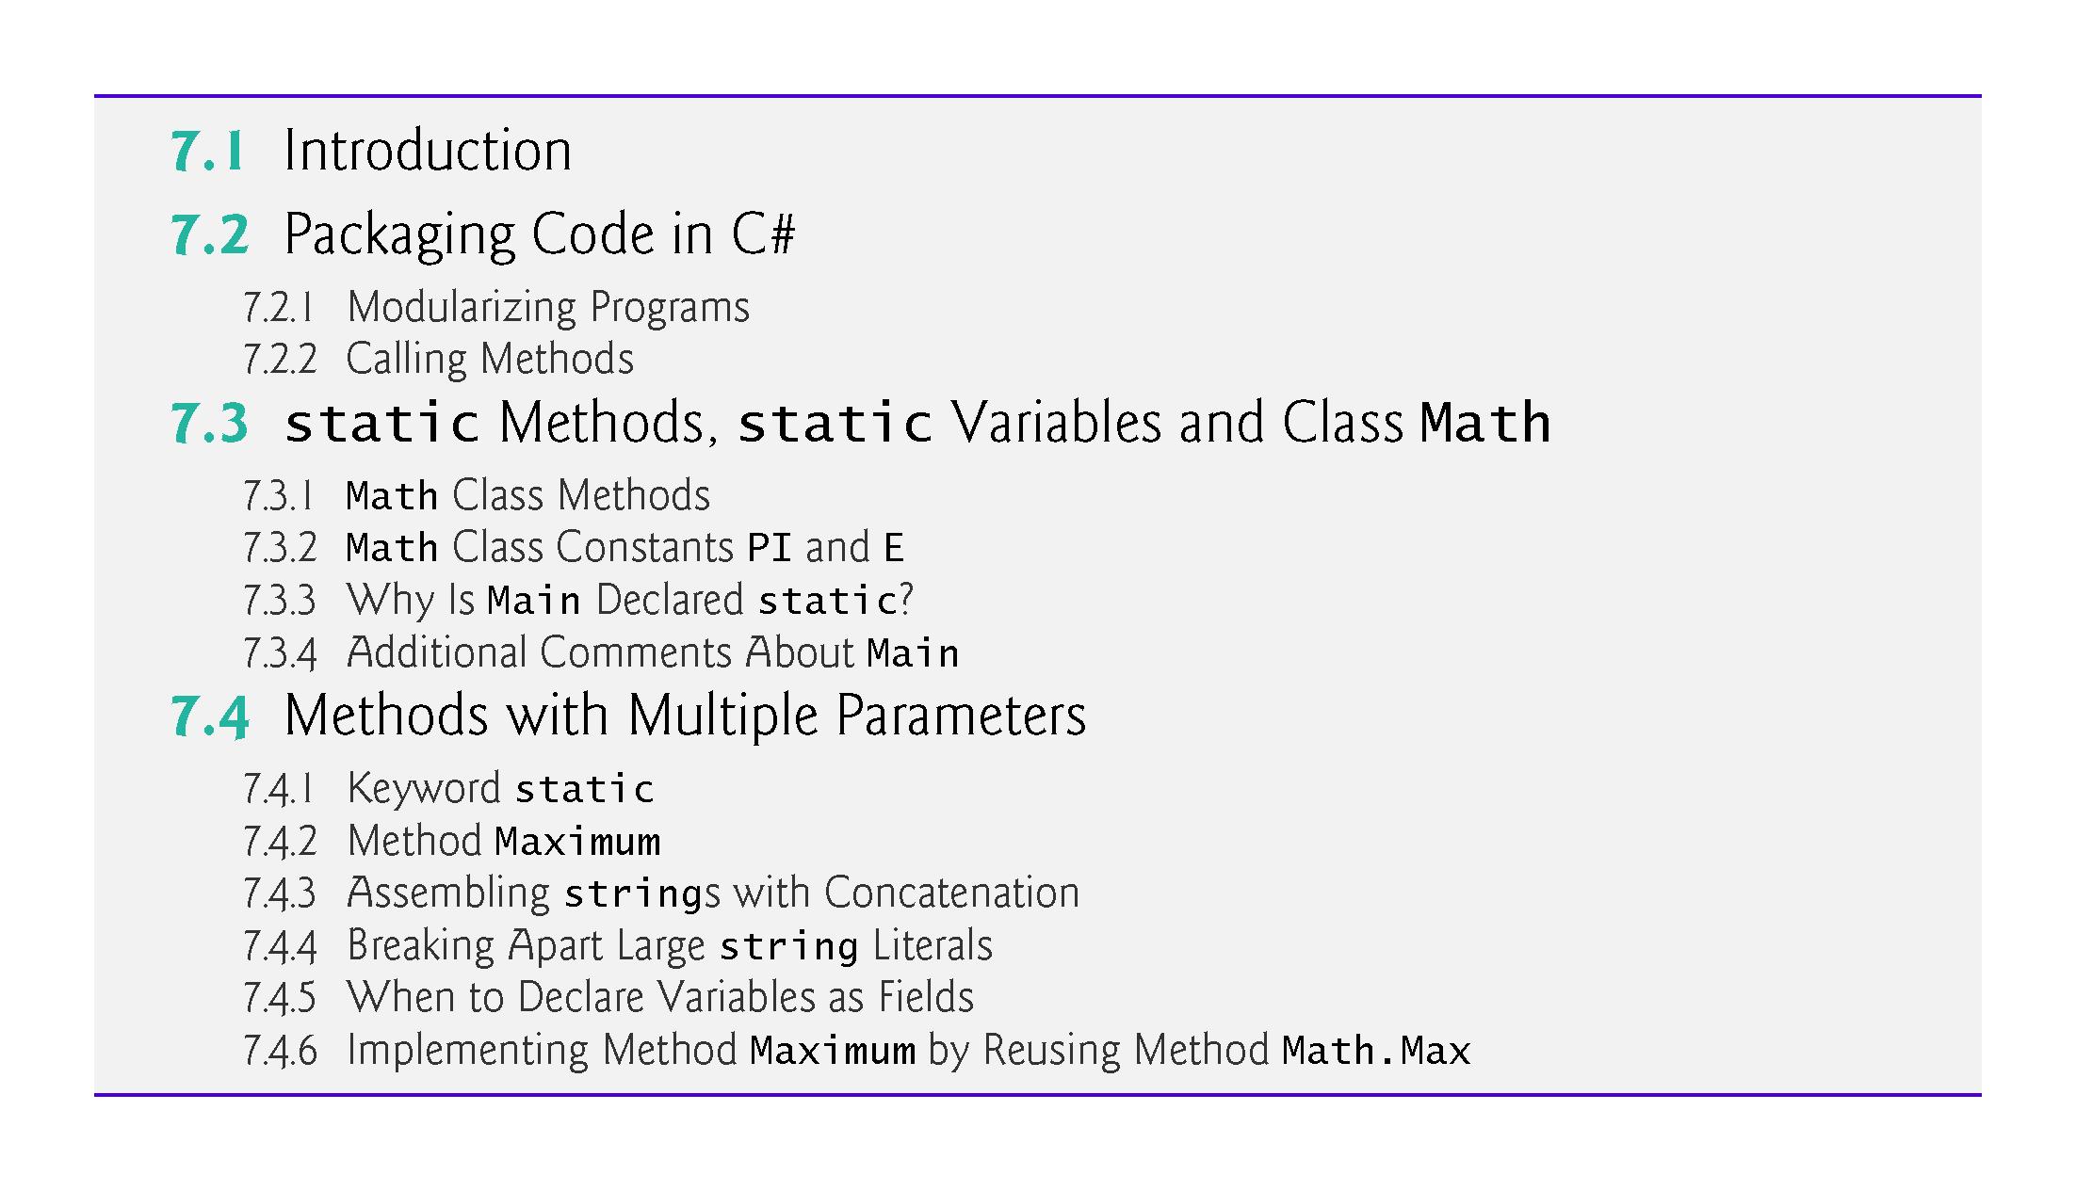

Slide 4
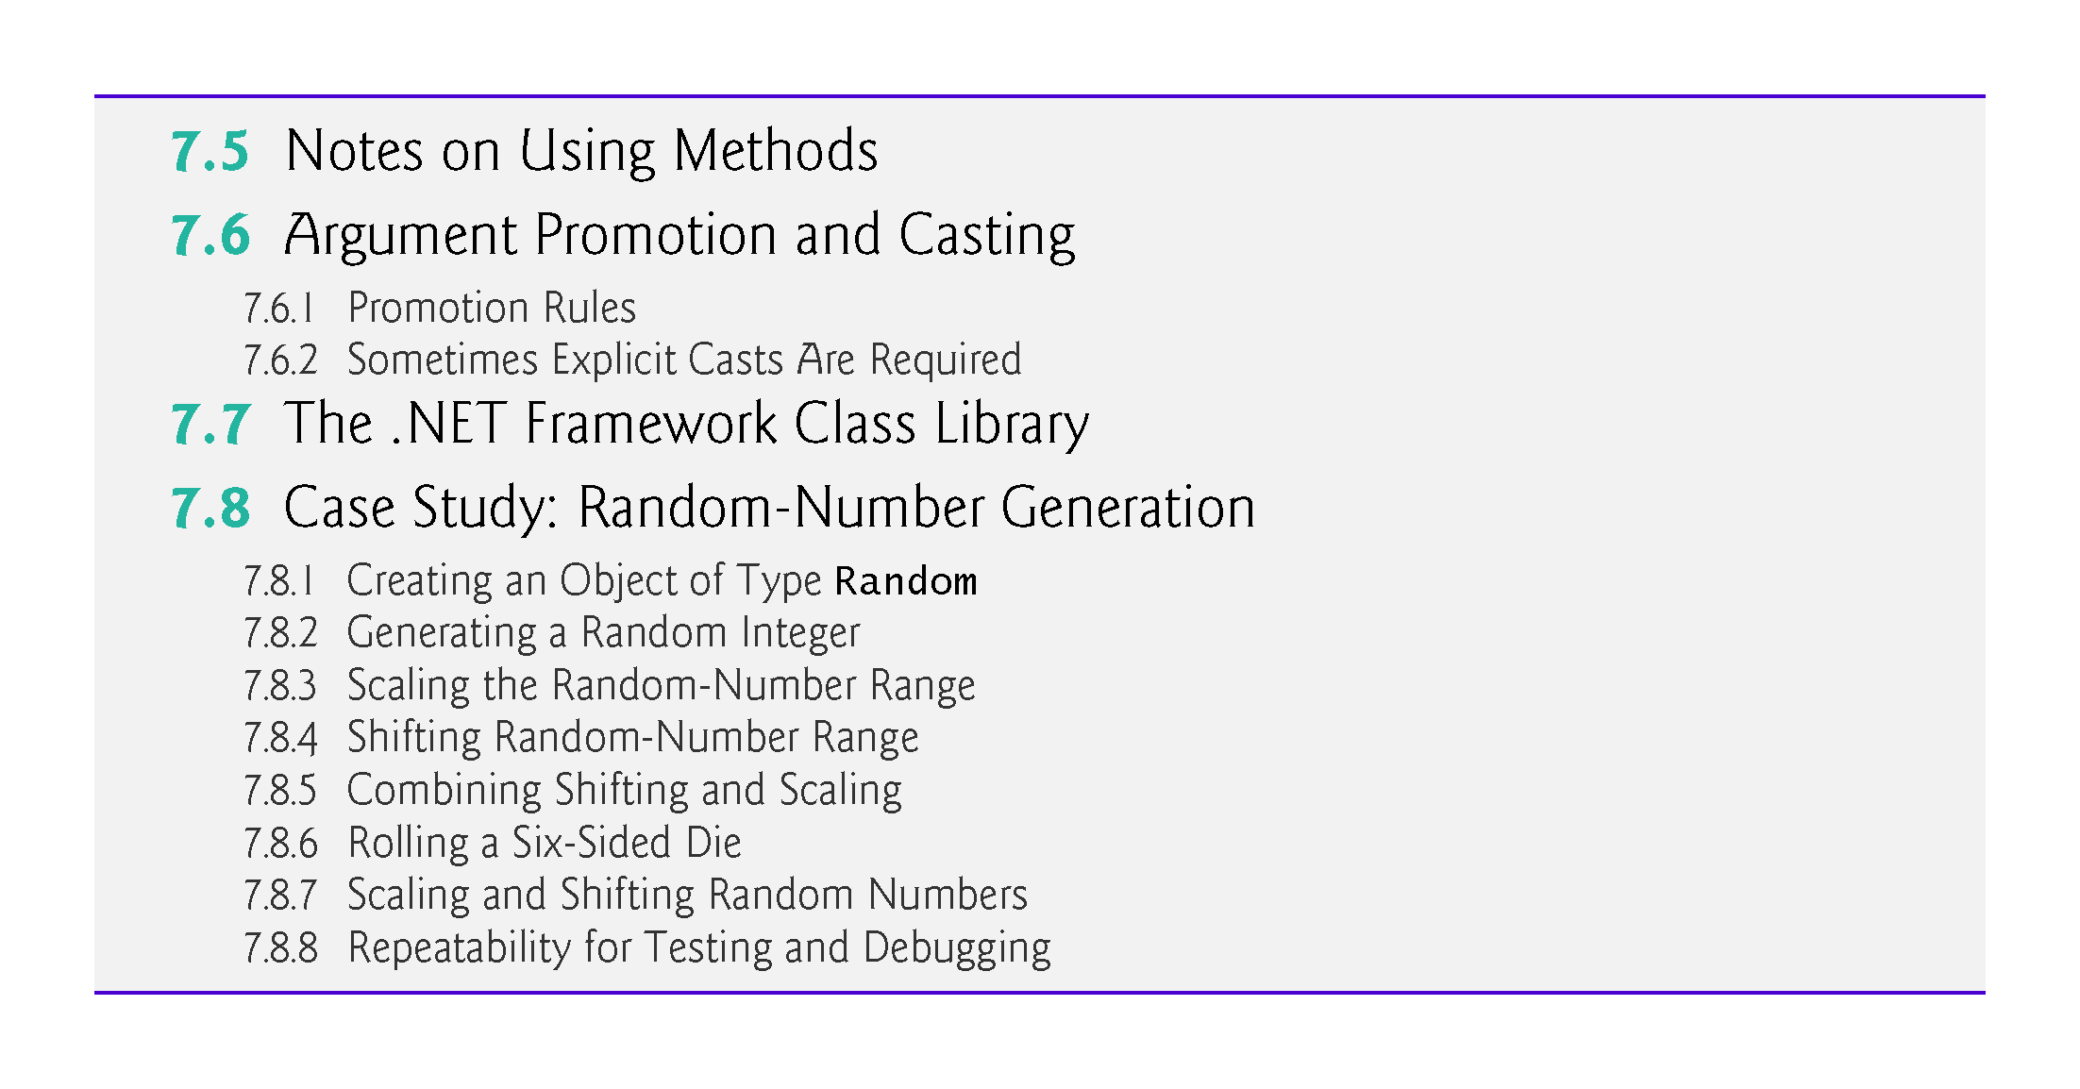

Slide 5
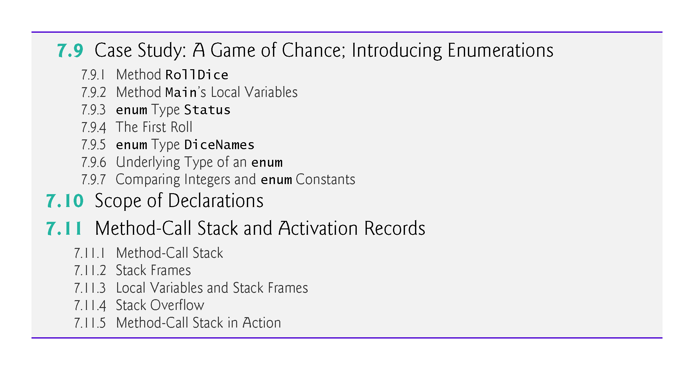

Slide 6
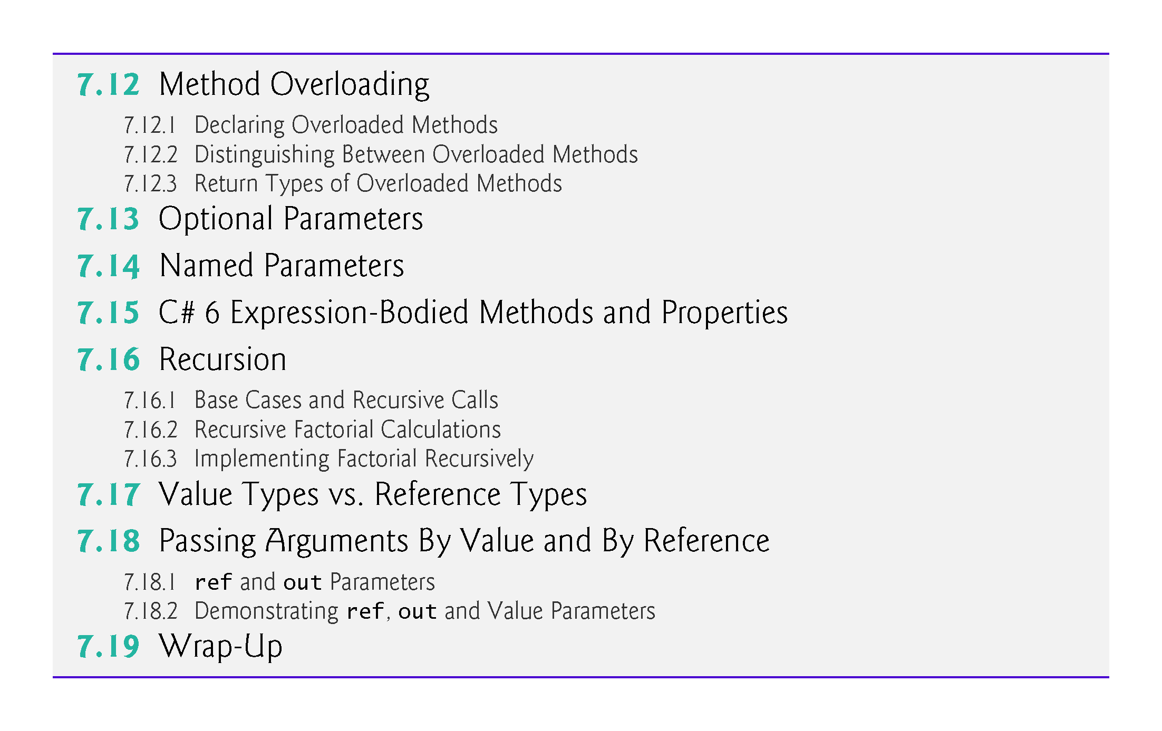

Slide 7
7.2 Packaging Code in C#
So far, we’ve used properties, methods and classes to package code.
C# apps are written by combining your properties, methods and classes with predefined properties, methods and classes available in the .NET Framework Class Library and in other class libraries.
Related classes are often grouped into namespaces and compiled into class libraries so that they can be reused in other apps.

Slide 8
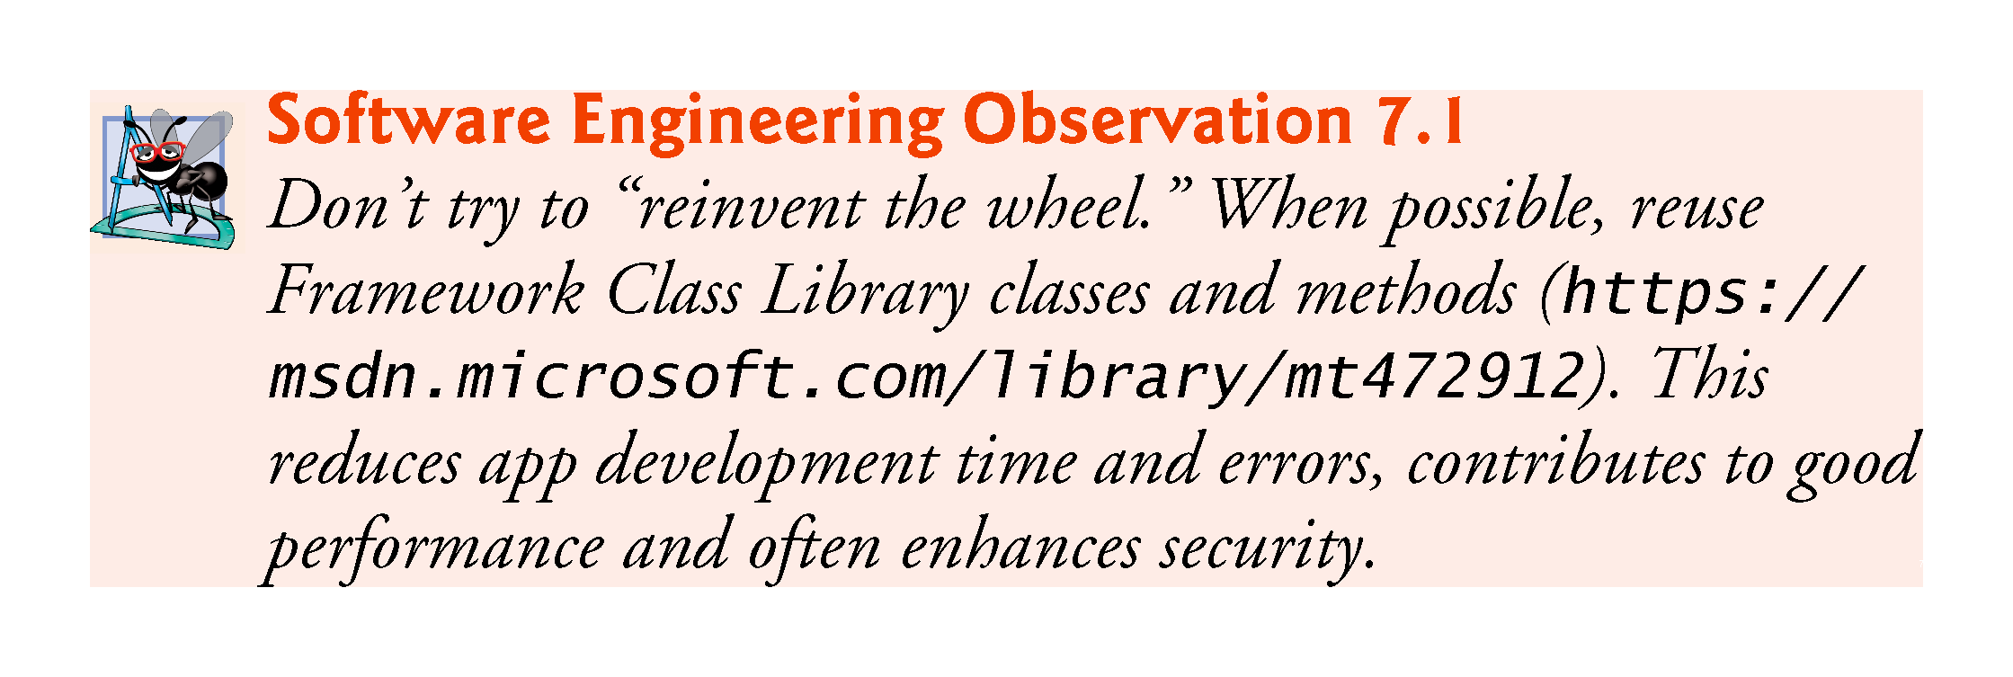

Slide 9
7.2.1 Modularizing Programs
Methods allow you to modularize an app by separating its tasks into reusable units.
Motivations for modularizing an app with methods
Software reuse—existing methods can be used as building blocks to create new apps.
Avoid repeating code.
Making programs easier to test, debug and maintain
Dividing an app into meaningful methods makes the app easier to debug and maintain.

Slide 10
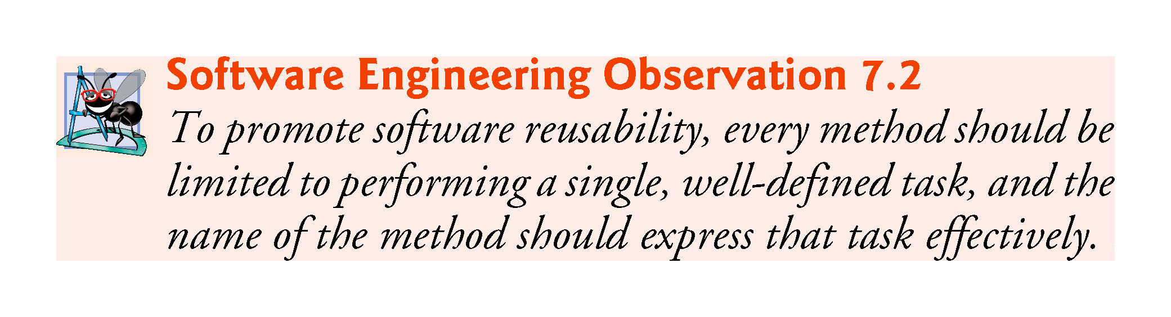

Slide 11
7.2.2 Calling Methods
As you know, a method is invoked by a method call, and when the called method completes its task, it returns control and possibly a result to its caller.
An analogy to the method-call-and-return structure is the hierarchical form of management (Fig. 7.1).
The boss method does not know how the worker method performs its designated tasks.
The worker may also call other worker methods.
This hiding of implementation details promotes good software engineering.

Slide 12
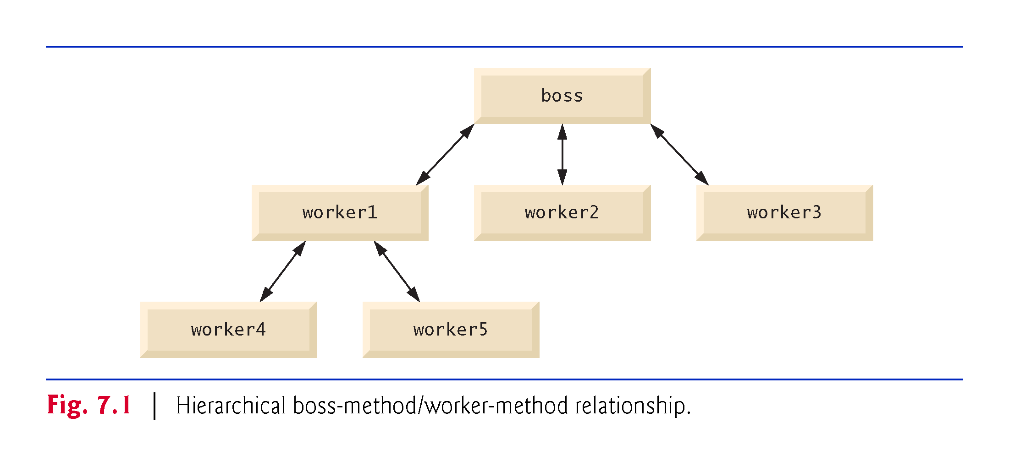

Slide 13
7.3 static Methods, static Variables and Class Math
A method that applies to the class in which it’s declared as a whole is known as a static method.
To declare a method as static, place the keyword static before the return type in the method’s declaration.
You call any static method by specifying the name of the class in which the method is declared, followed by the member access (.) operator and the method name.

Slide 14
7.3.1 Math Class Methods
Class Math provides a collection of static methods that enable you to perform common mathematical calculations.
You do not need to create a Math object before calling method Sqrt.
Method arguments may be constants, variables or expressions.

Slide 15
7.3.1 Math Class Methods
Figure 7.2 summarizes several Math class methods. In the figure, x and y are of type double.

Slide 16
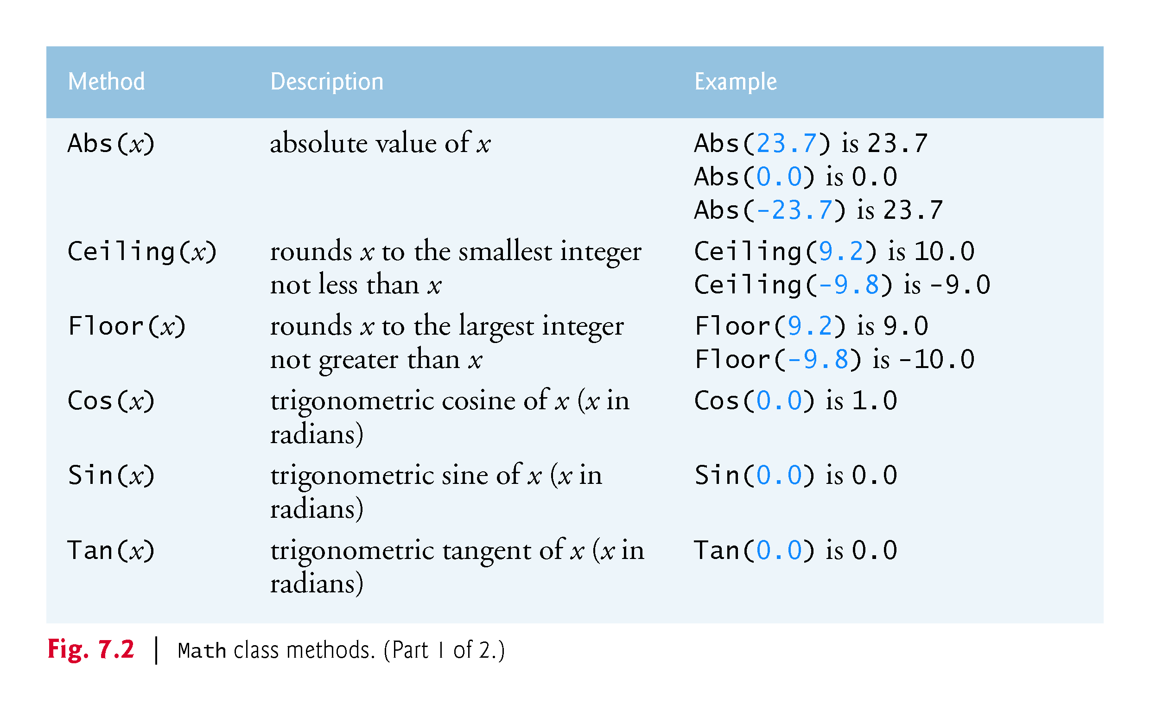

Slide 17
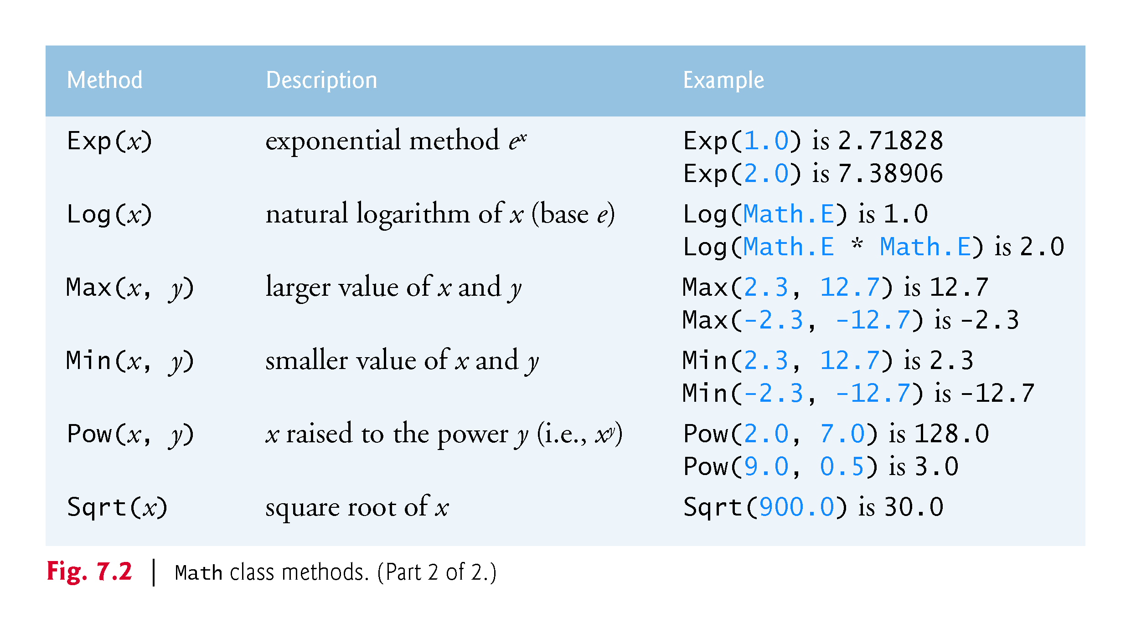

Slide 18
7.3 static Methods, static Variables and Class Math (Cont.)
When objects of a class containing static variables are created, all the objects of that class share one copy of the class’s static variables.
Together the static variables and instance variables represent the fields of a class.

Slide 19
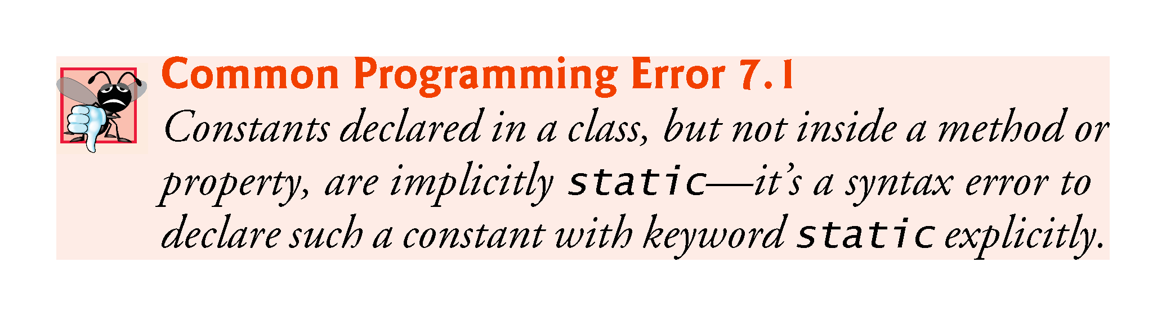

Slide 20
7.3.3 Why Is Main Declared static?
Main is sometimes called the app’s entry point.
Declaring Main as static allows the execution environment to invoke Main without creating an instance of the class.

Slide 21
7.3.4 Additional Comments about Main
You can place a Main method in every class you declare.
Some programmers take advantage of this to build a small test app into each class they declare.
If you declare more than one Main method among the classes of your project, you’ll need to indicate to the IDE which one you would like to be the app’s entry point:
With the project open in Visual Studio, select Project > [ProjectName] Properties... (where [ProjectName] is the name of your project).
Select the class containing the Main method that should be the entry point from the Startup object list box.

Slide 22
7.4 Methods with Multiple Parameters
Fig. 7.3 declares method Maximum which determines and returns the largest of three double values.

Slide 23
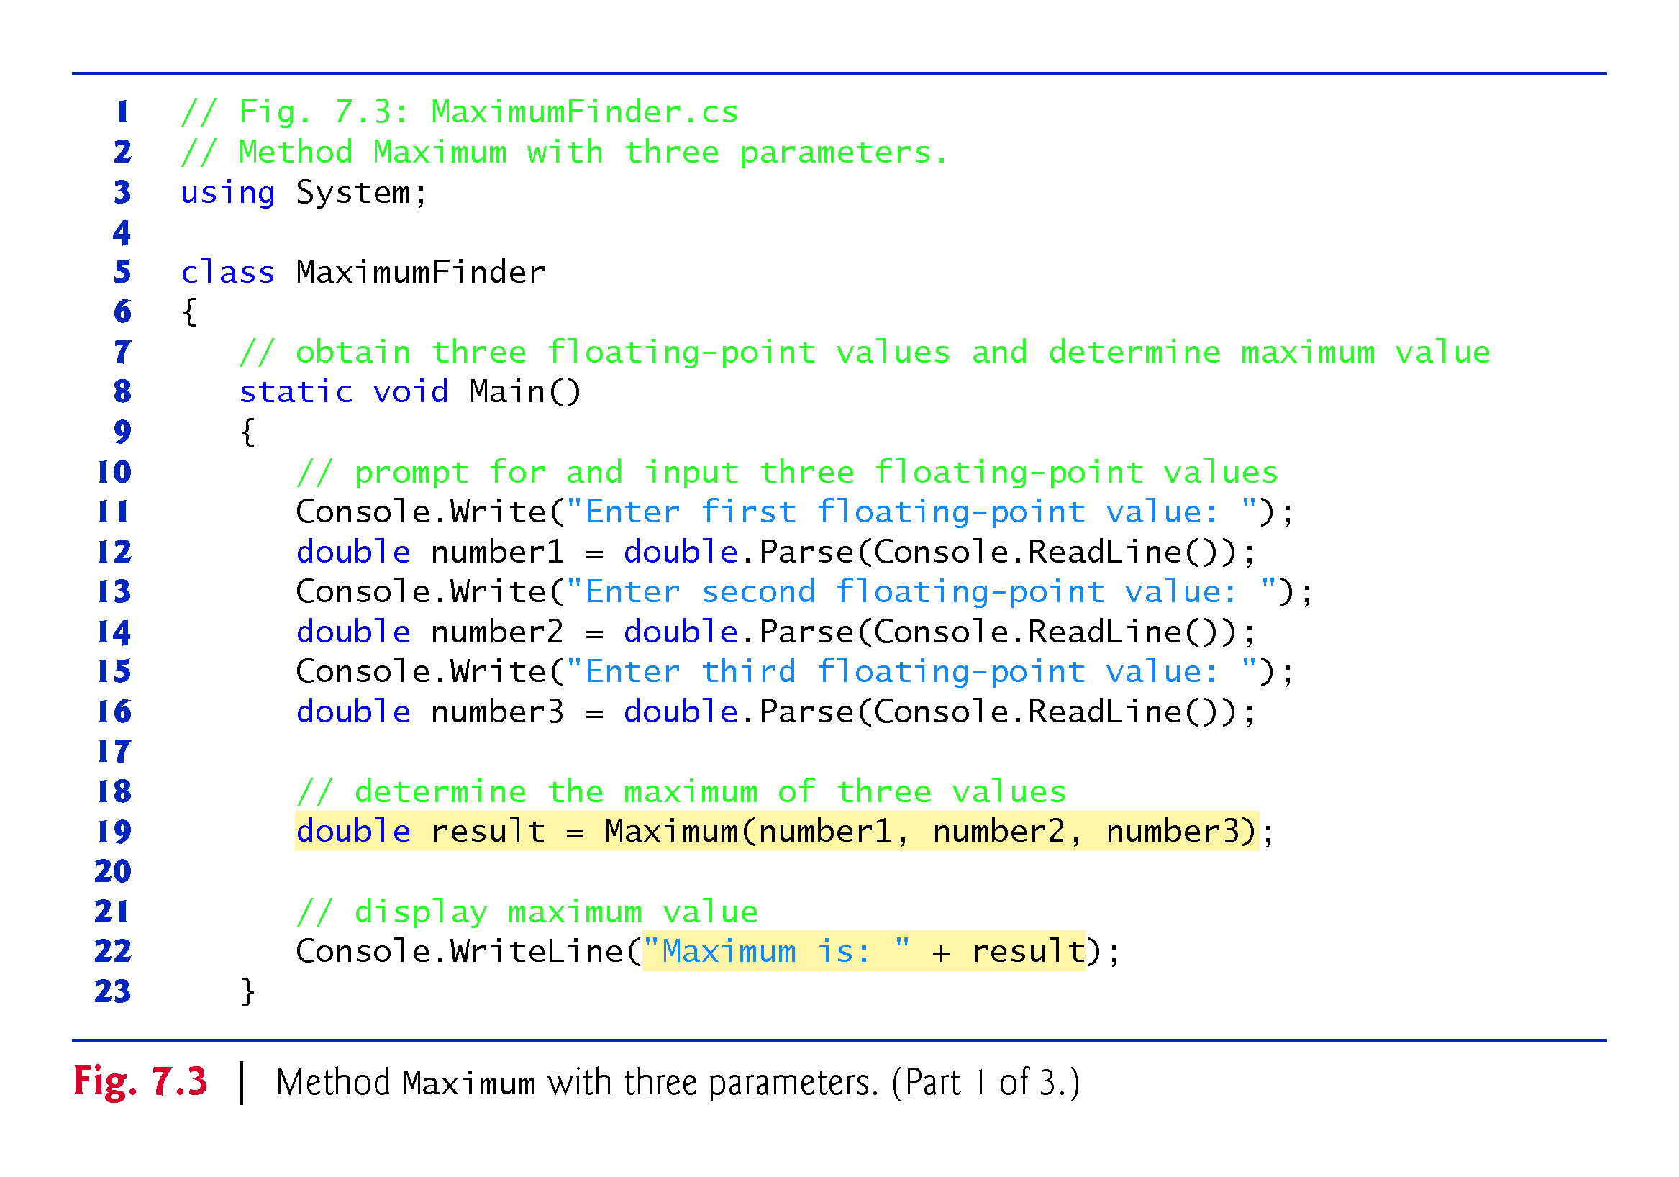

Slide 24
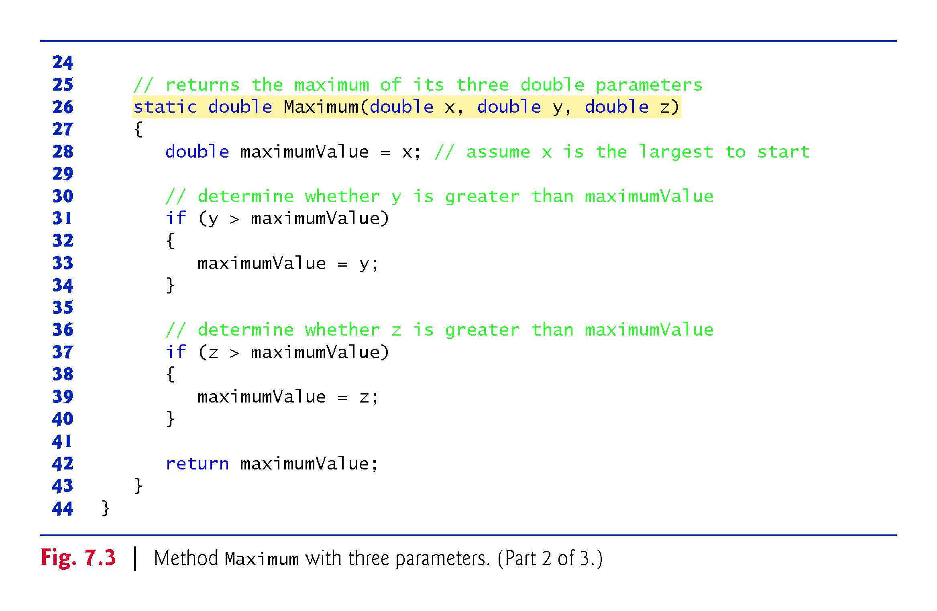

Slide 25
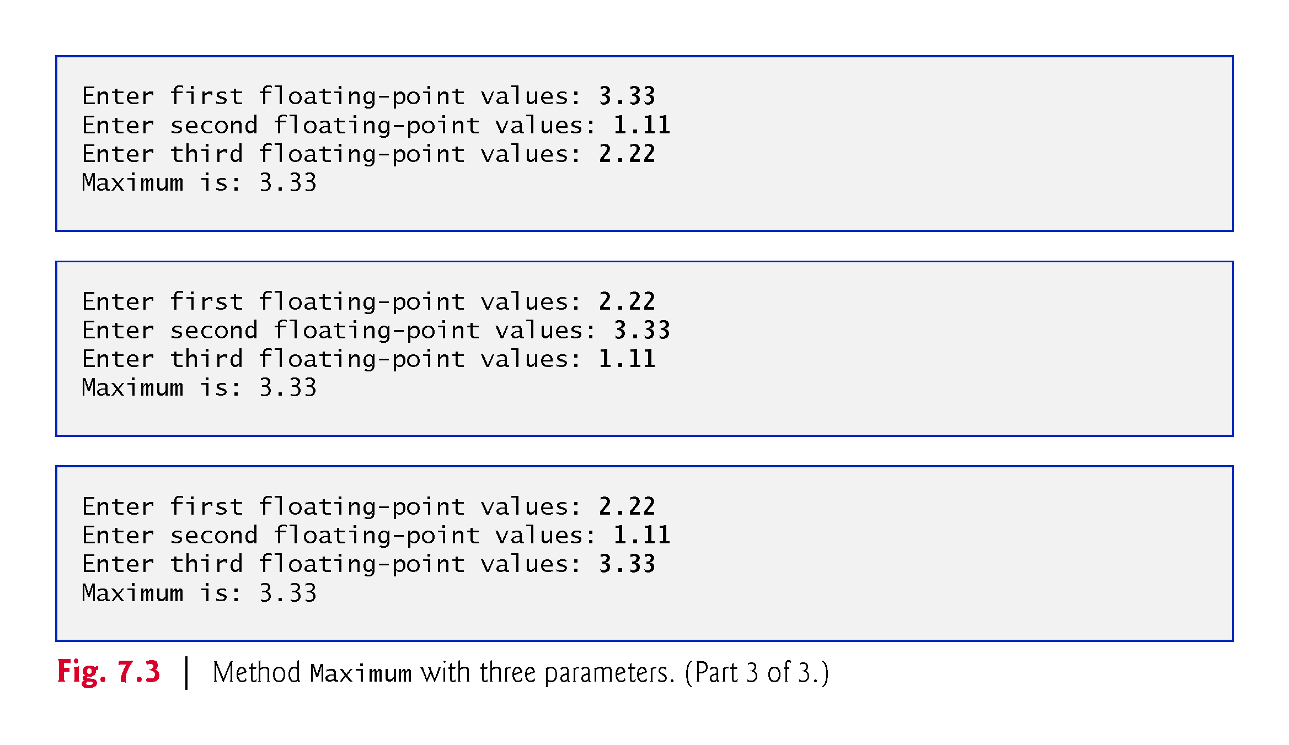

Slide 26
7.4.1 Keyword static
Method Maximum’s declaration begins with keyword static, which enables the Main method (another static method) to call Maximum as shown in line 19 without creating an object of class MaximumFinder and without qualifying the method name with the class name MaximumFinder.
Static methods in the same class can call each other directly.

Slide 27
7.4.2 Method Maximum
When a method has more than one parameter, the parameters are specified as a comma-separated list.
There must be one argument in the method call for each required parameter (sometimes called a formal parameter) in the method declaration.
Each argument must be consistent with the type of the corresponding parameter.
When program control returns from a method, that method’s parameters are no longer accessible in memory.
Methods can return at most one value.

Slide 28
7.4 Methods with Multiple Parameters (Cont.)
When to Declare Variables as Fields of a Class
Variables should be declared as fields of a class only if they are required for use in more than one method or if the app needs to save their values between calls to the class’s methods.

Slide 29
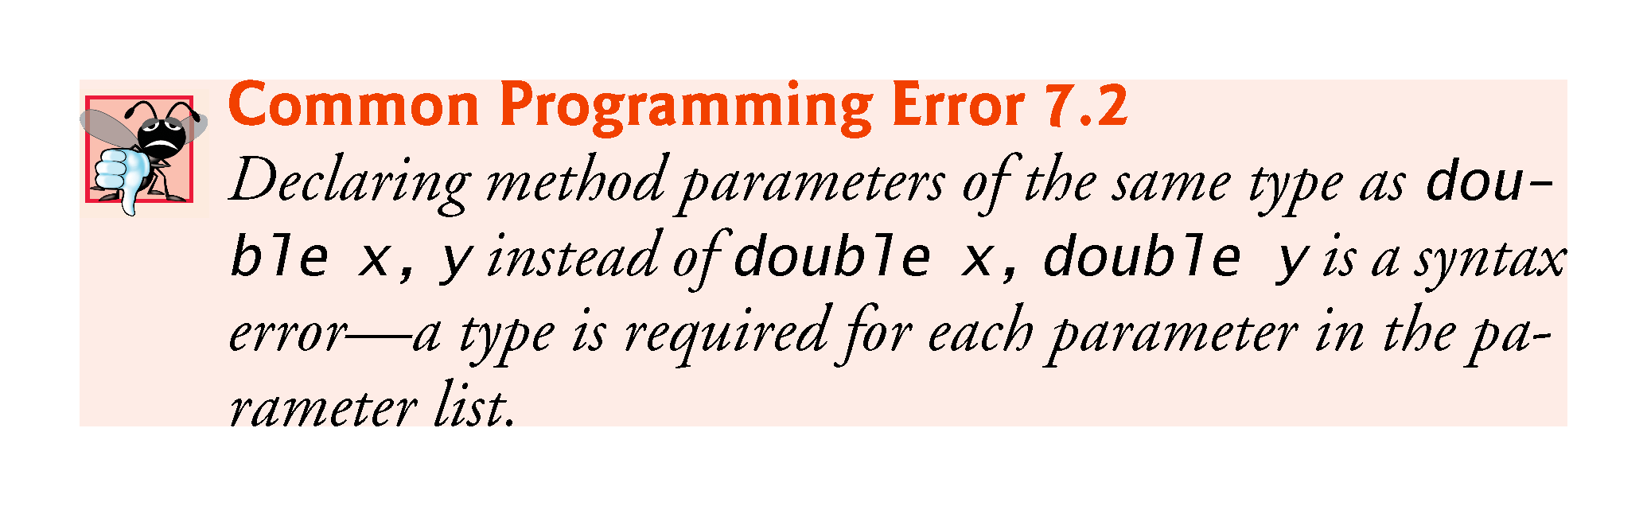

Slide 30
7.4.3 Assembling strings with Concatenation
string concatenation allows you to combine strings using operator + .
When one of the + operator’s operands is a string, the other is implicitly converted to a string, then the two are concatenated.
If a bool is concatenated with a string, the bool is converted to the string "True" or "False".

Slide 31
7.4.3 Assembling strings with Concatenation
string concatenation allows you to combine strings using + .
When one of the + operator’s operands is a string, the other is implicitly converted to a string, then the two are concatenated.
If a bool is concatenated with a string, the bool is converted to the string "True" or "False".
Every object has a ToString method that returns a string representation of that object.
When an object is concatenated with a string, the object’s ToString method is called implicitly to obtain the string representation of the object. If the object is null, an empty string is written.

Slide 32
7.4.3 Assembling strings with Concatenation
If a type does not define a ToString method, the default ToString implementation returns a string containing the type’s fully qualified name.
Each type you create can declare a custom ToString (Chapter 8).
Line 22 of could also be written using string interpolation as
Console.WriteLine($"Maximum is: {result}");
As with string concatenation, using string interpolation to insert an object into a string implicitly calls the object’s ToString method to obtain the object’s string representation.

Slide 33
7.4.4 Breaking Apart Large string Literals
A large string literal in a program can be broken into several smaller strings and placed them on multiple lines for readability, and reassembled using string concatenation

Slide 34
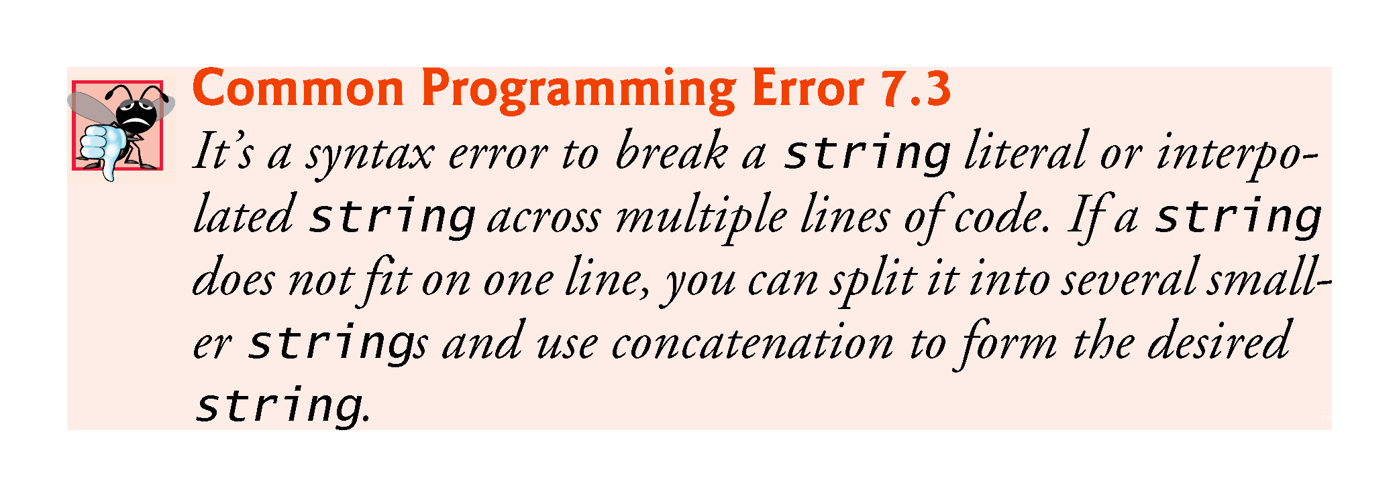

Slide 35
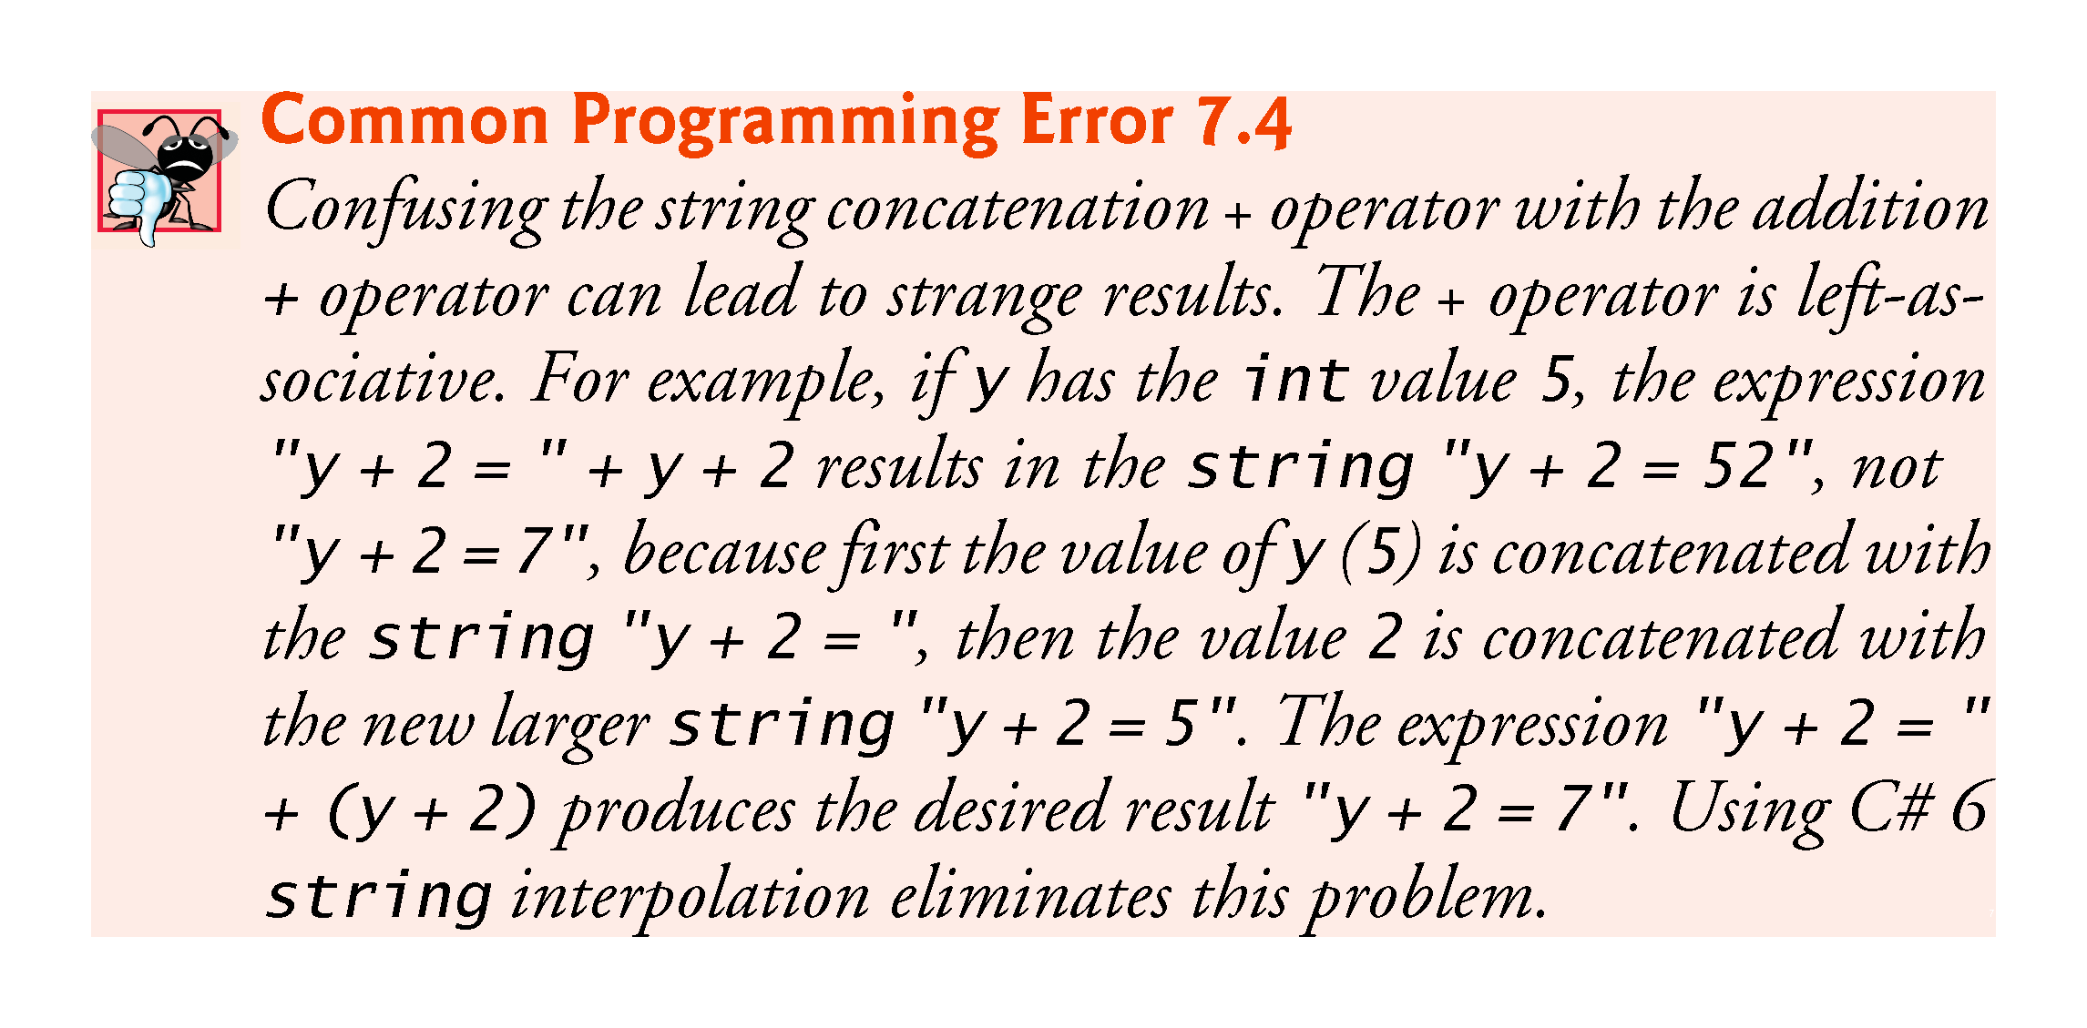

Slide 36
7.4.5 When to Declare Variables as Fields
Variables should be declared as fields of a class (i.e., as either instance variables or static variables) only if they’re required for use in more than one method of the class or if the app should save their values between calls to a given method.

Slide 37
7.4.6 Implementing Method Maximum by Reusing Method Math.Max
The entire body of our maximum method could also be implemented with nested calls to Math.Max, as follows:
return Math.Max(x, Math.Max(y, z));
Before any method can be called, the .NET runtime evaluates all its arguments to determine their values.
Math.Max(y, z) is evaluated first, then the result is passed as the second argument to the other call to Math.Max

Slide 38
7.5 Notes on Using Methods
Three ways to call a method:
Using a method name by itself to call a method of the same class
Maximum(number1, number2, number3)
Using a reference to an object, followed by the member-access operator (.) and the method name to call a non-static method of the referenced object
account1.Deposit(depositAmount)
Using the class name and the member-access operator (.) to call a static method of a class
Console.ReadLine()
Math.Sqrt(900.0)

Slide 39
7.5 Notes on Using Methods
Three ways to return control to the statement that calls a method.
Reaching the end of the method.
A return statement without a value.
A return statement with a value.

Slide 40
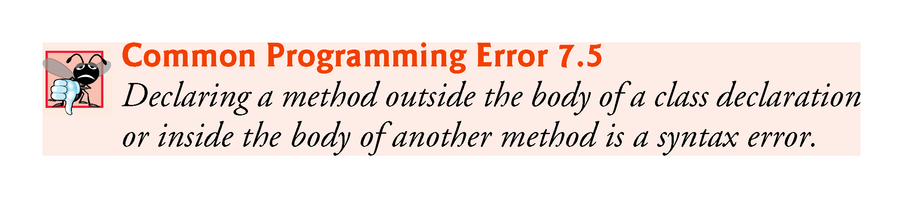

Slide 41
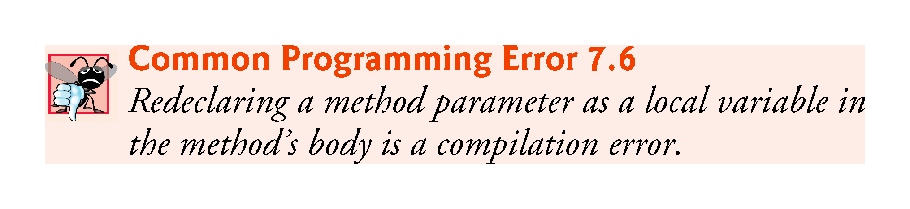

Slide 42
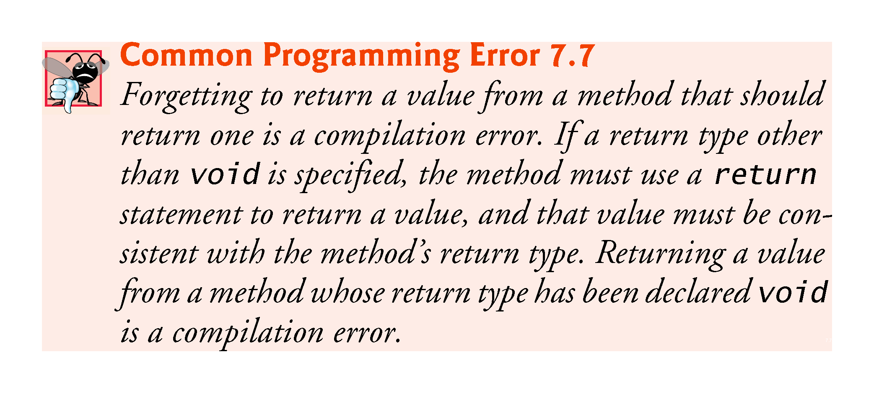

Slide 43
7.5 Notes on Using Methods (cont.)
A static method or property can call only other static methods or properties of the same class directly and can manipulate only static variables in the same class directly.
To access a class’s non-static members, a static method or property must use a reference to an object of that class.
Many objects of a class, each with its own copies of the instance variables, may exist at the same time.

Slide 44
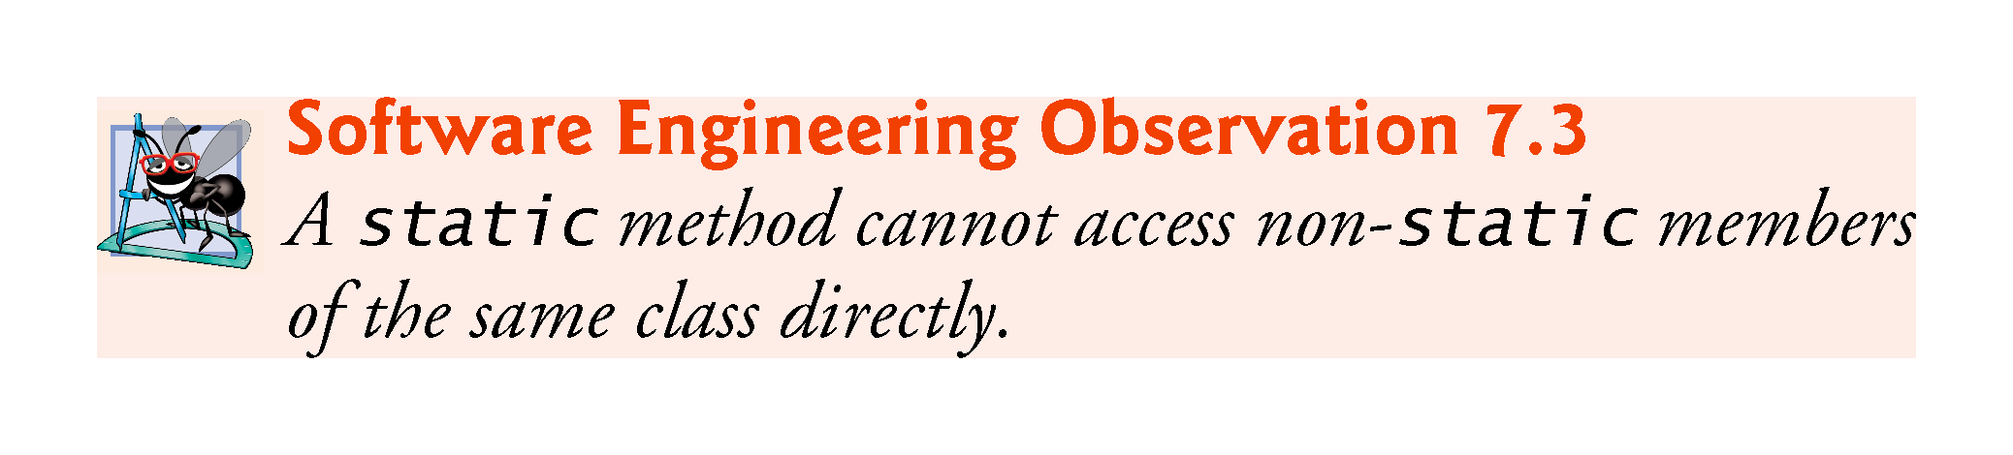

Slide 45
7.6 Argument Promotion and Casting
Argument promotion is the implicit conversion of an argument’s value to the type that the method expects to receive.
These conversions generate compile errors if they don’t follow C#’s promotion rules; these specify which conversions can be performed without losing data.
An int can be converted to a double without changing its value.
A double cannot be converted to an int without loss of data.
Converting large integer types to small integer types (e.g., long to int) can also result in changed values.
The types of the original values remain unchanged.

Slide 46
7.6.1 Promotion Rules
Figure 7.4 lists the simple types alphabetically and the types to which each can be promoted.

Slide 47
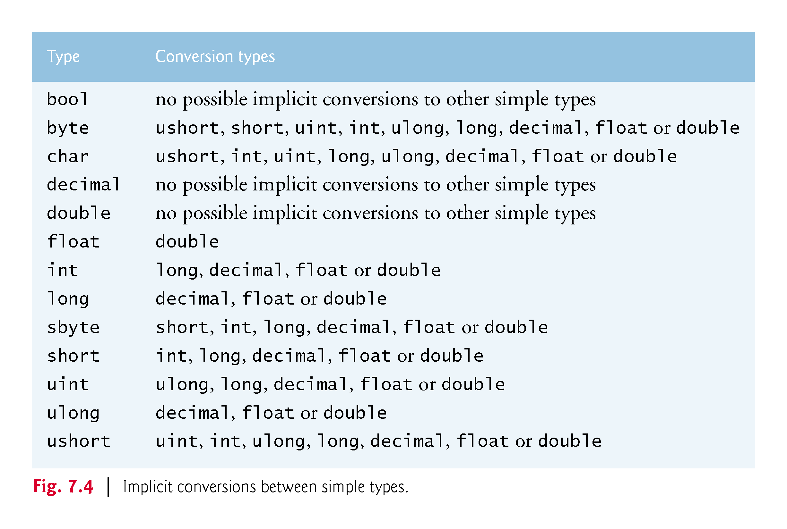

Slide 48
7.6.2 Sometimes Explicit Casts Are Required
All simple types can also be implicitly converted to type object.
In cases where information may be lost, you must use a cast operator to force the conversion.

Slide 49
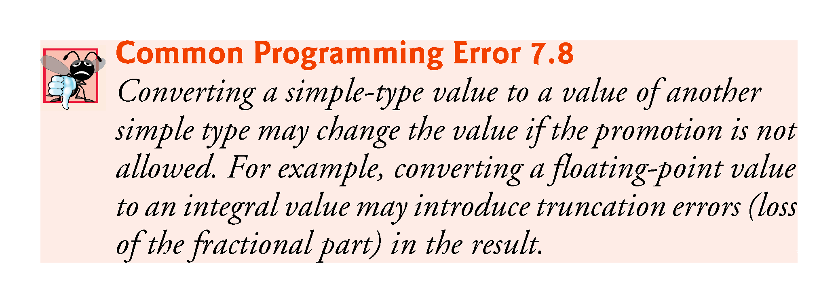

Slide 50
7.7 The .NET Framework Class Library
Predefined classes are grouped into categories of related classes called namespaces.

Slide 51
7.7 The .NET Framework Class Library
Throughout the text, using directives allow us to use library classes from the Framework Class Library without specifying their namespace names.
An app would include the declaration
using System;
in order to use the class names from the System namespace without fully qualifying their names.
This allows you to use the unqualified name Console, rather than the fully qualified name System.Console, in your code.

Slide 52
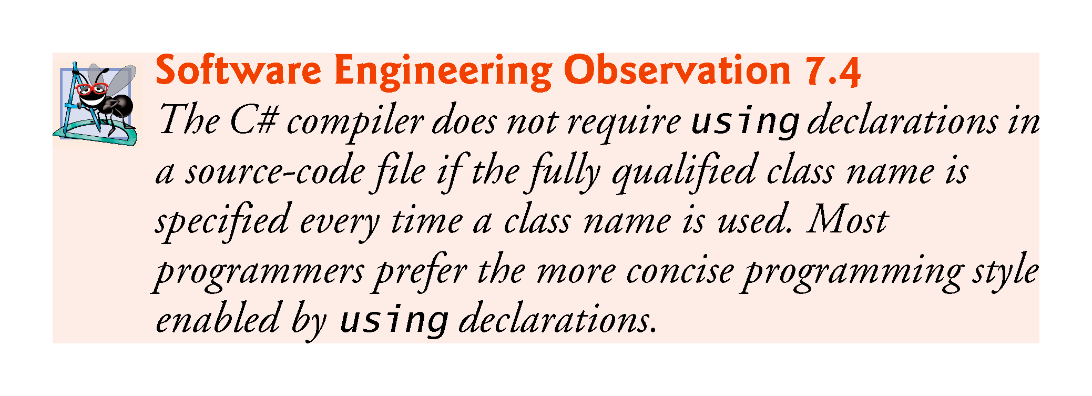

Slide 53
7.7 The .NET Framework Class Library
There’s a special relationship between classes in a project
By default, such classes are in the same namespace and can be used by other classes in the project.
Thus, a using declaration is not required when one class in a project uses another in the same project.
Also, any classes that are not explicitly placed in a namespace are implicitly placed in the so-called global namespace.

Slide 54
7.7 The .NET Framework Class Library
A strength of C# is the large number of classes in the namespaces of the .NET Framework Class Library.
Some key Framework Class Library namespaces are described in Fig. 7.5.

Slide 55
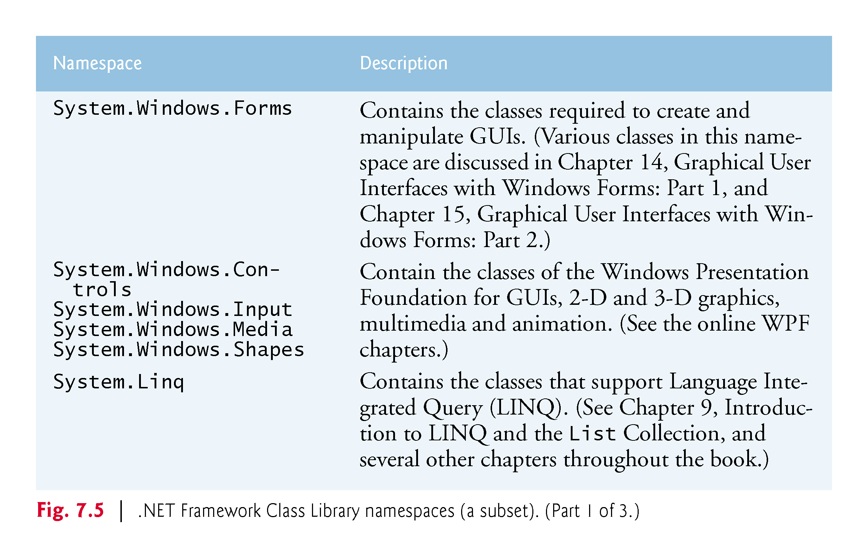

Slide 56
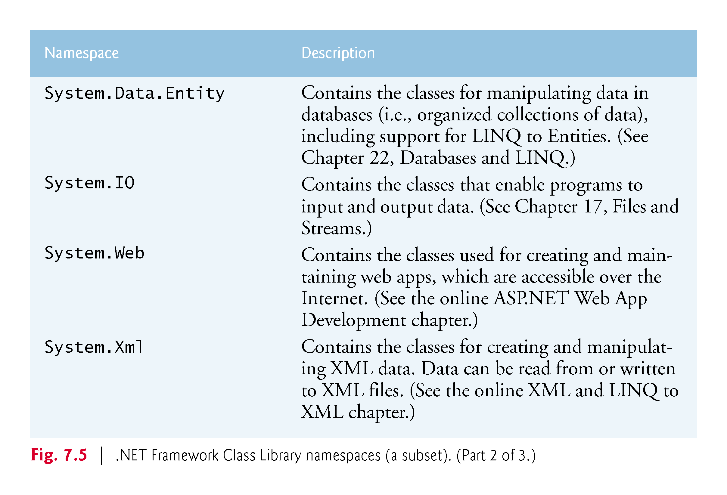

Slide 57
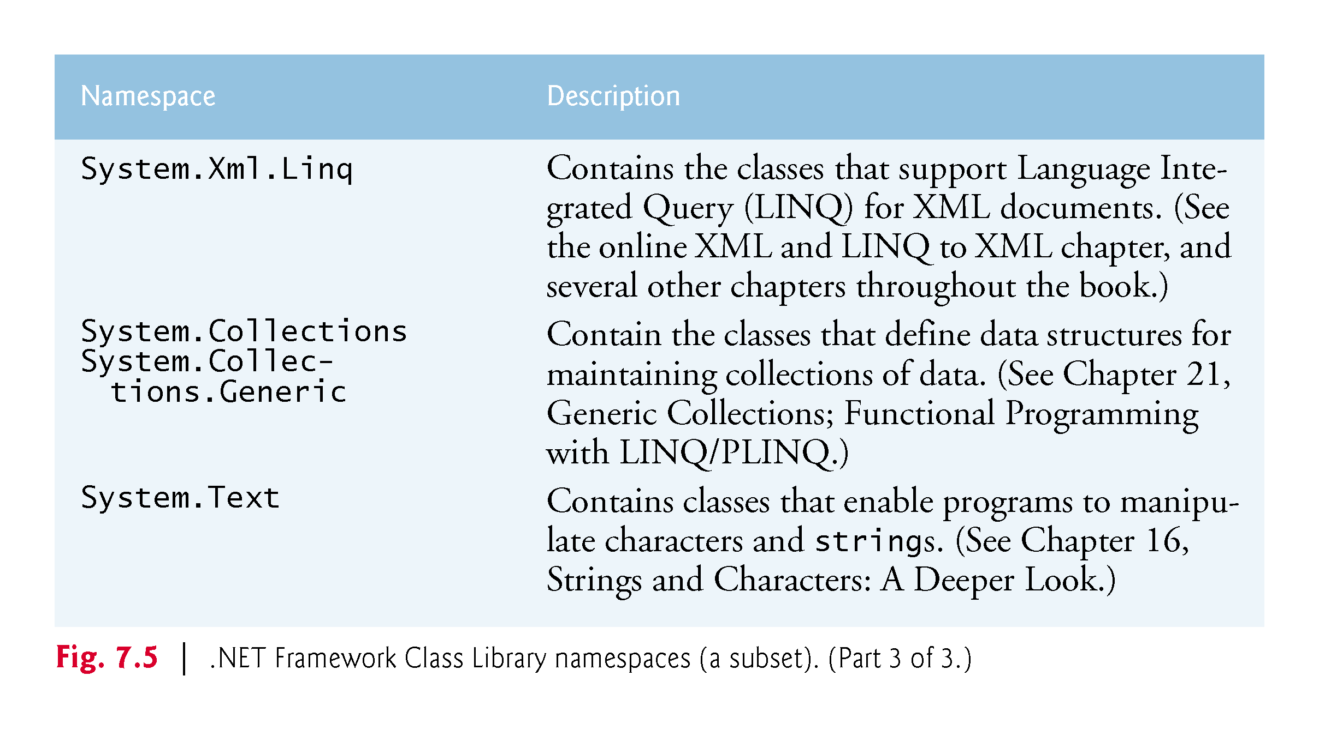

Slide 58
7.7 The .NET Framework Class Library
You can locate additional information about a .NET class’s methods in the .NET Framework Class Library reference
https://msdn.microsoft.com/library/mt472912

Slide 59
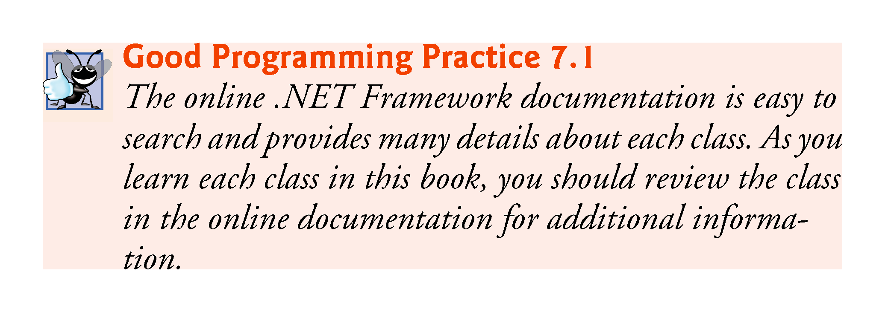

Slide 60
7.8 Case Study: Random-Number Generation
Objects of class Random can produce random byte, int and double values.
According to Microsoft’s documentation for class Random, the random values it produces “are not completely random because a mathematical algorithm is used to select them, but they are sufficiently random for practical purposes.”
If your app requires so-called cryptographically secure random numbers, use class RNGCryptoServiceProvider from namespace System.Security.Cryptography) to produce random values

Slide 61
7.8.1 Creating an Object of Type Random
A new random-number generator object can be created with class Random (from the System namespace) as follows:
Random randomNumbers = new Random();

Slide 62
7.8.2 Generating a Random Integer
Method Next of class Random generates a random int value.
range 0 to +2,147,483,646, inclusive
The values returned by Next are actually pseudorandom numbers—a sequence of values produced by a complex mathematical calculation.
The calculation uses the current time of day to seed the random-number generator.

Slide 63
7.8.3 Scaling the Random-Number Range
If you supply the Next method with an argument—called the scaling factor—it returns a value from 0 up to, but not including, the argument’s value.

Slide 64
7.8.4 Shifting Random-Number Range
You can also shift the range of numbers produced by adding a shifting value to the number returned by the Next method.

Slide 65
7.8.5 Combining Shifting and Scaling
If you provide Next with two int arguments, it returns a value from the first argument’s value up to, but not including, the second argument’s value.

Slide 66
7.8.6 Rolling a Six-Sided Die
Figure 7.6 shows two sample outputs of an app that simulates 20 rolls of a six-sided die and displays each roll’s value.

Slide 67
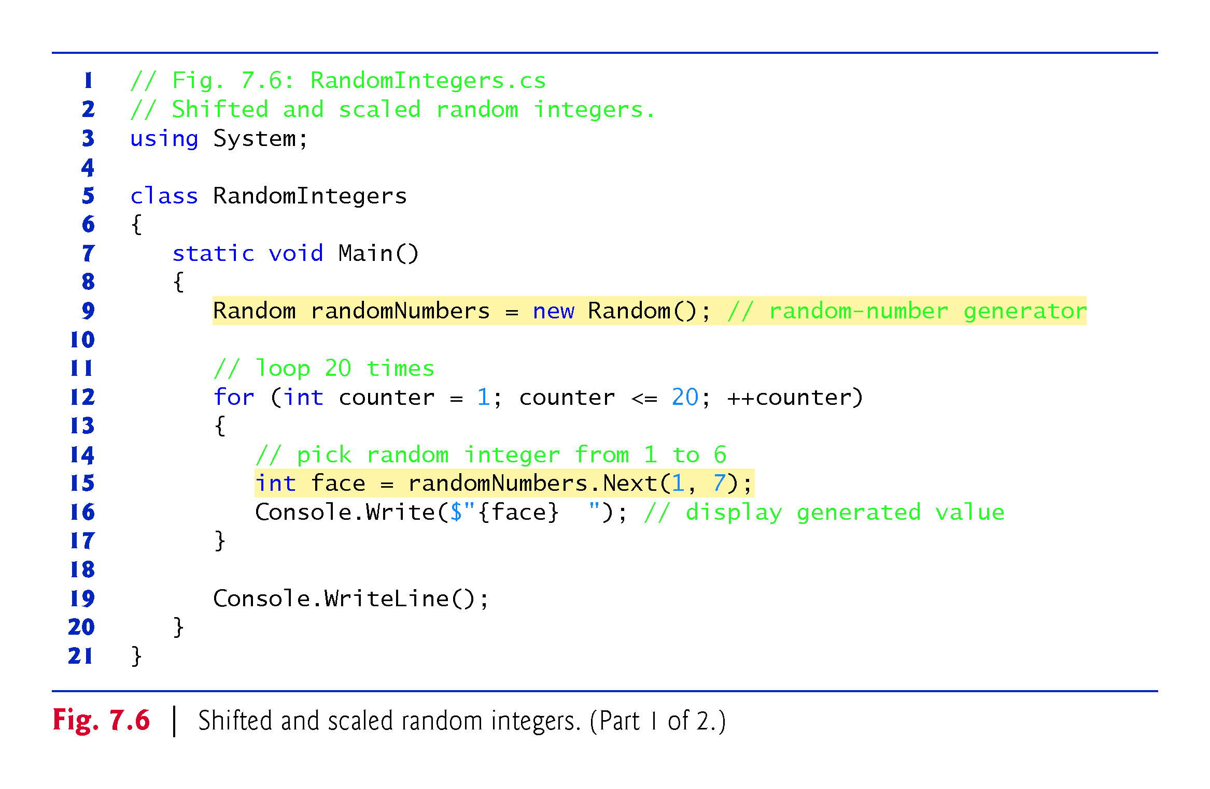

Slide 68
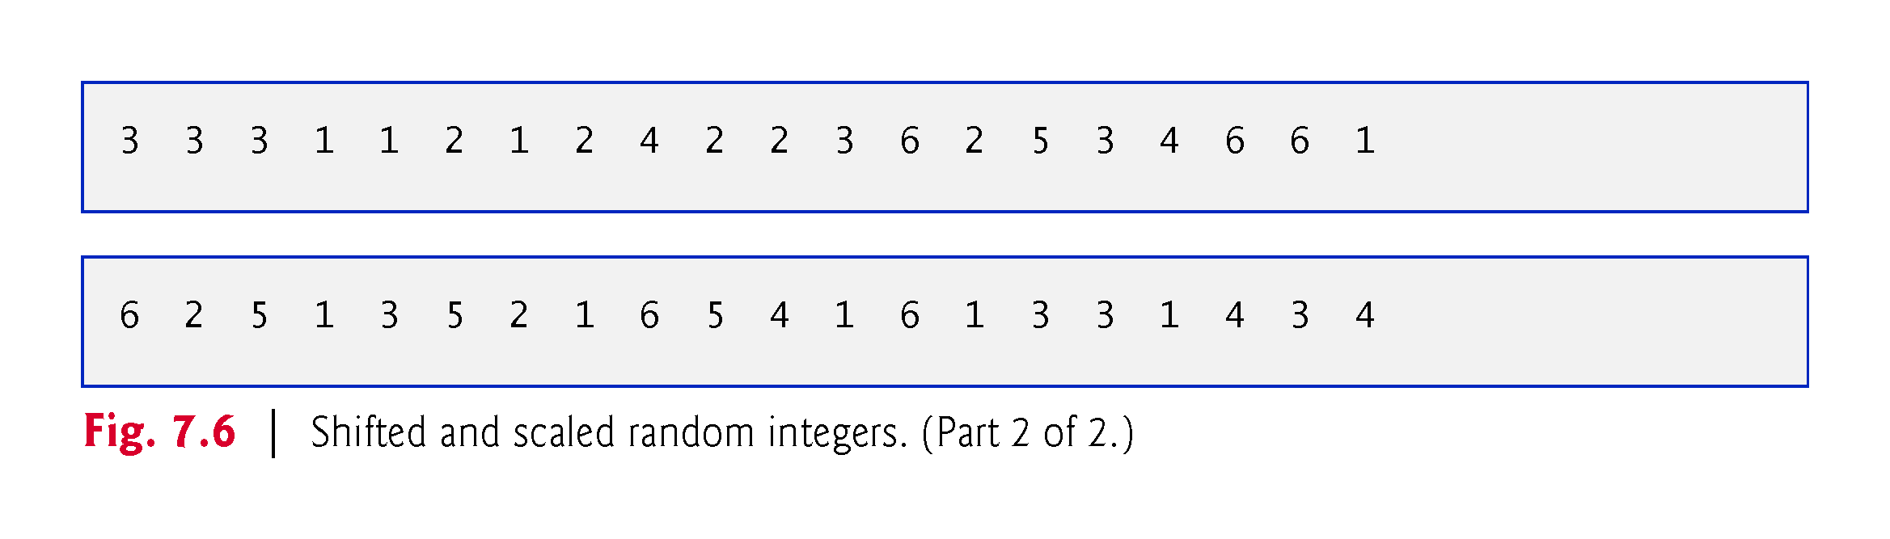

Slide 69
7.8.6 Rolling a Six-Sided Die
The app in Fig. 7.7 simulates 60,000,000 rolls of a die. Each integer from 1 to 6 should appear approximately 10,000,000 times.
The values produced by method Next enable the app to realistically simulate rolling a six-sided die.

Slide 70
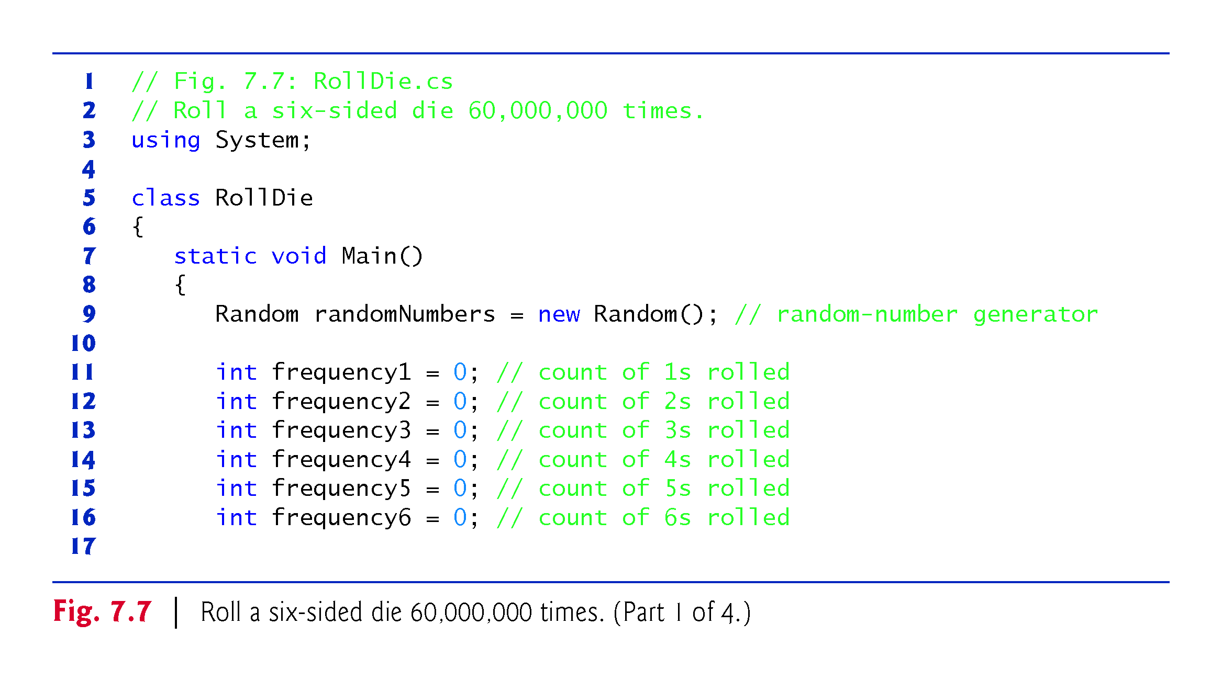

Slide 71
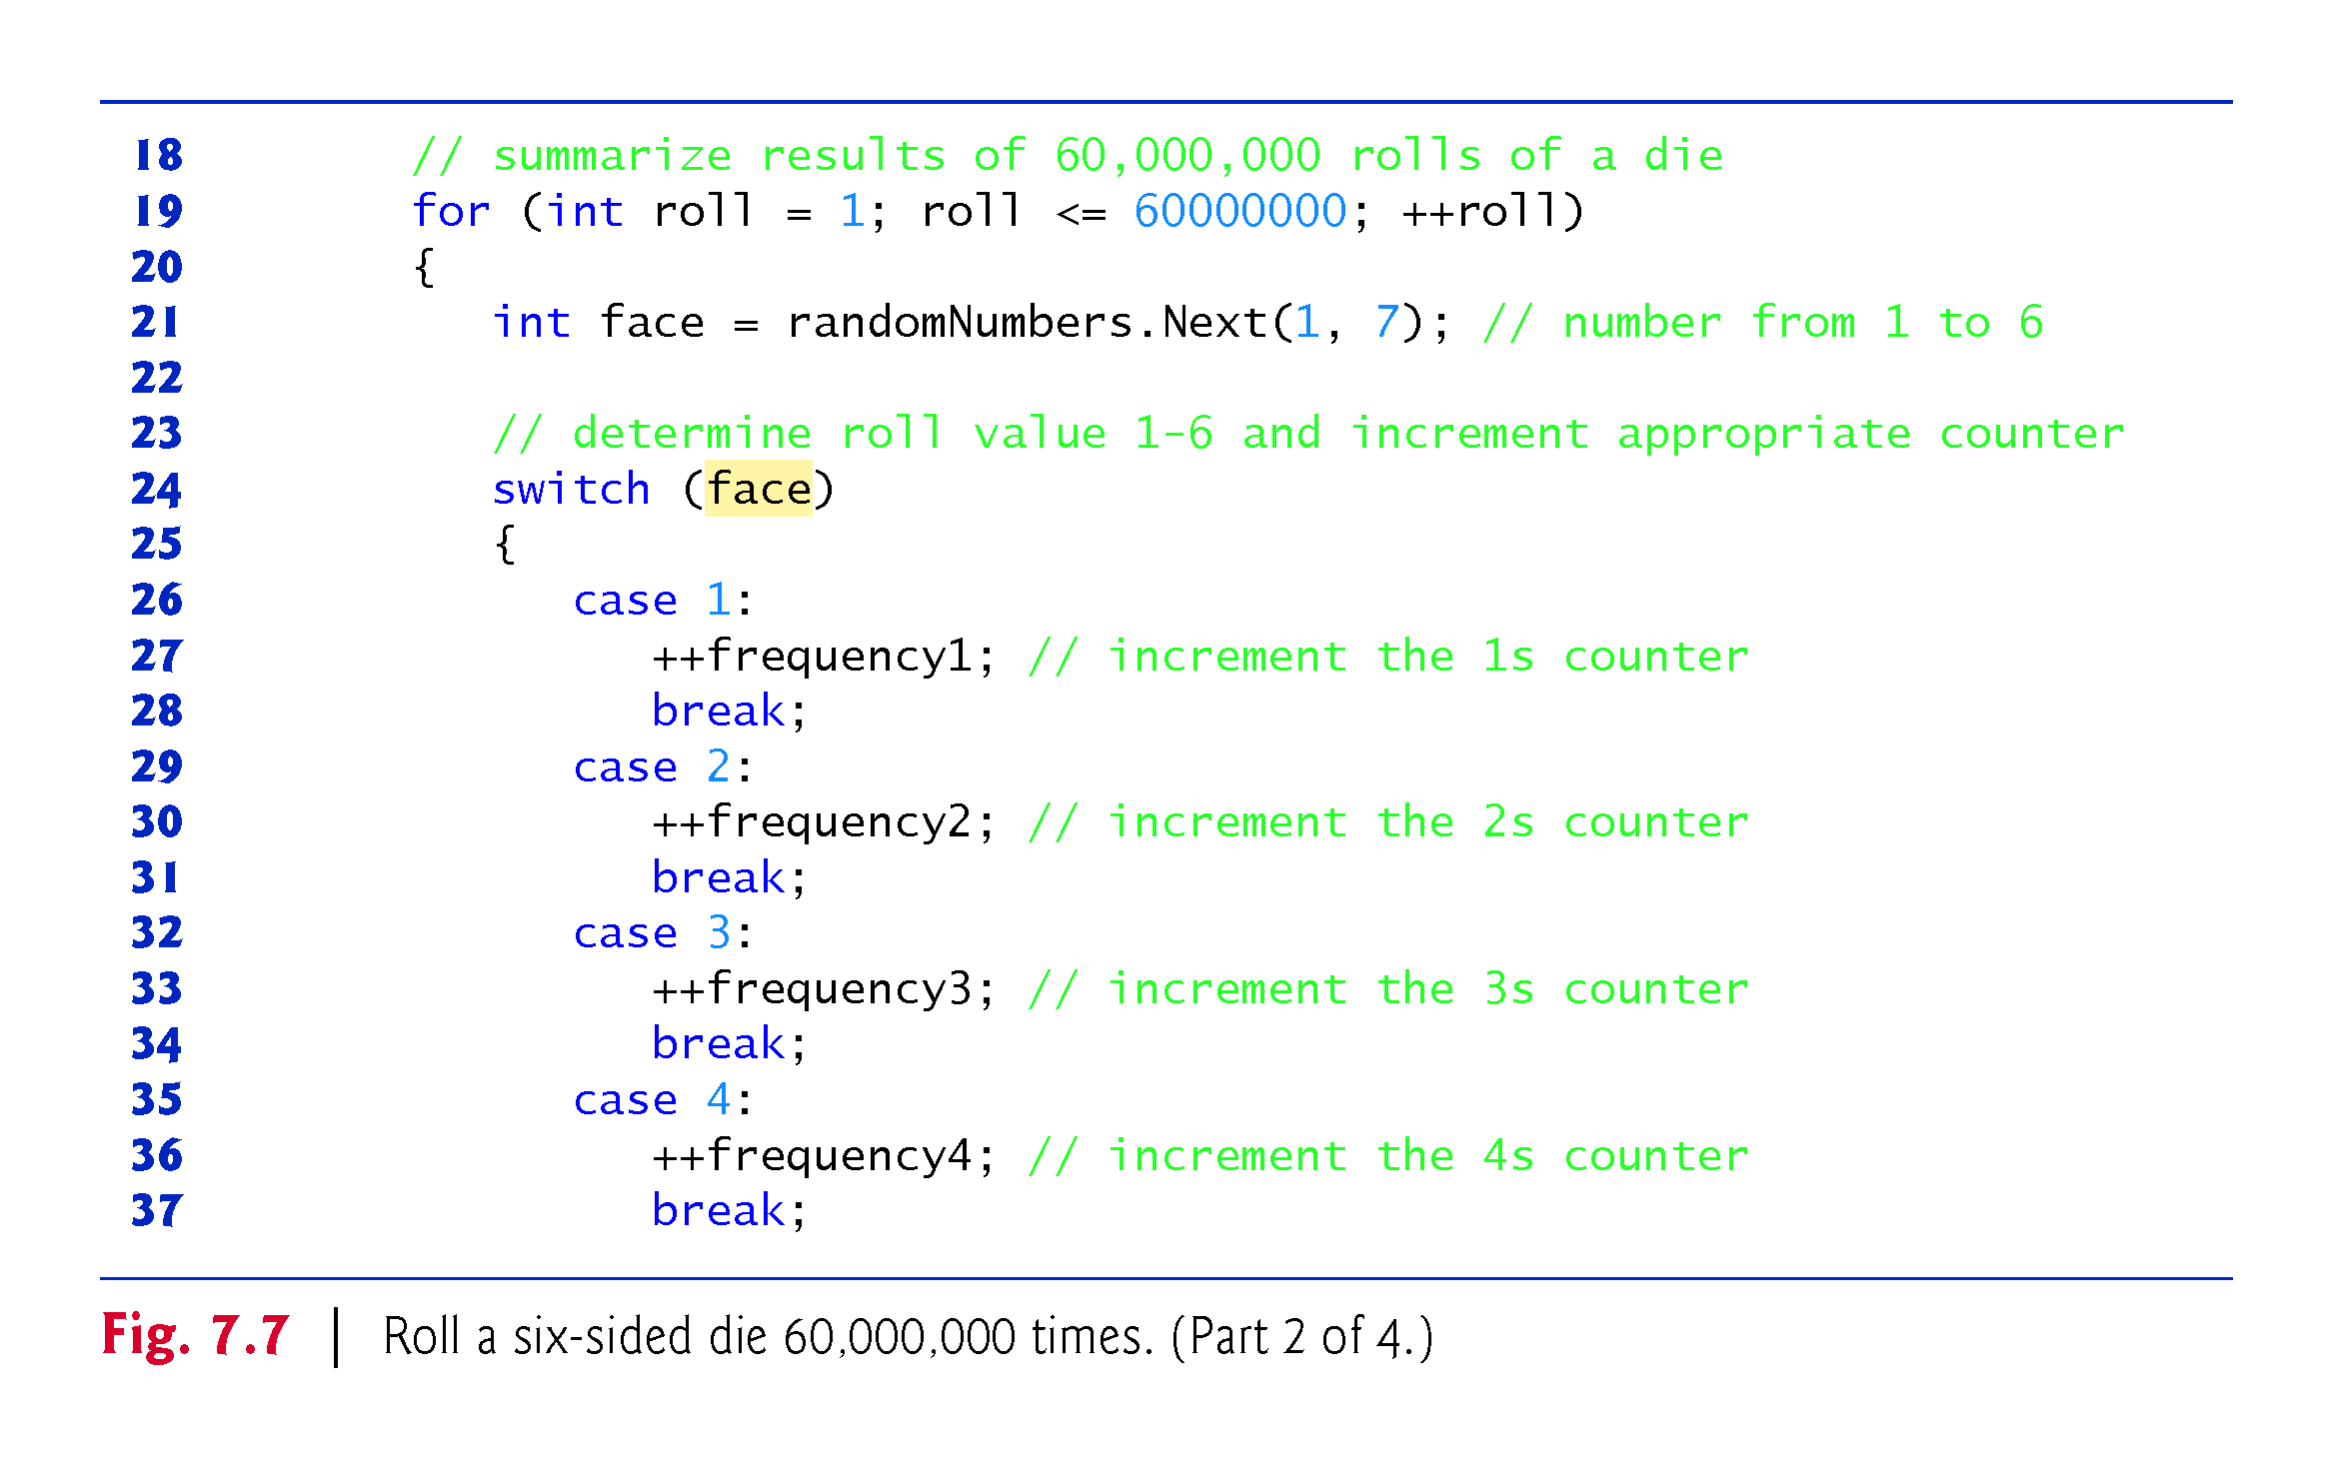

Slide 72
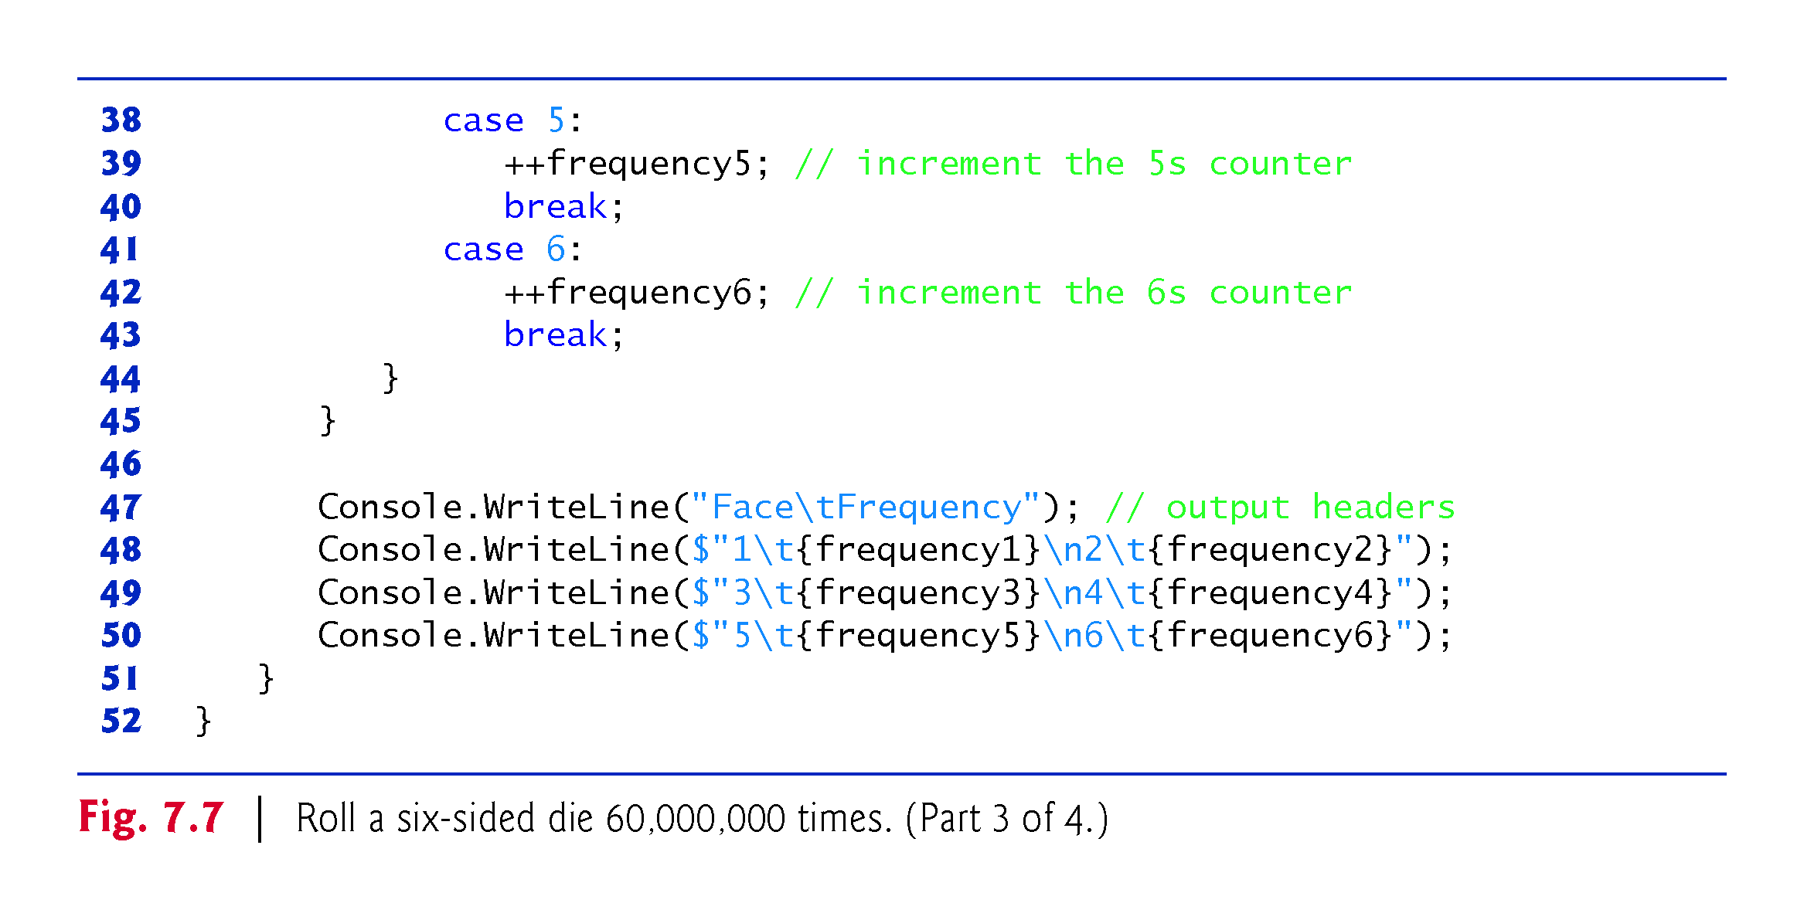

Slide 73
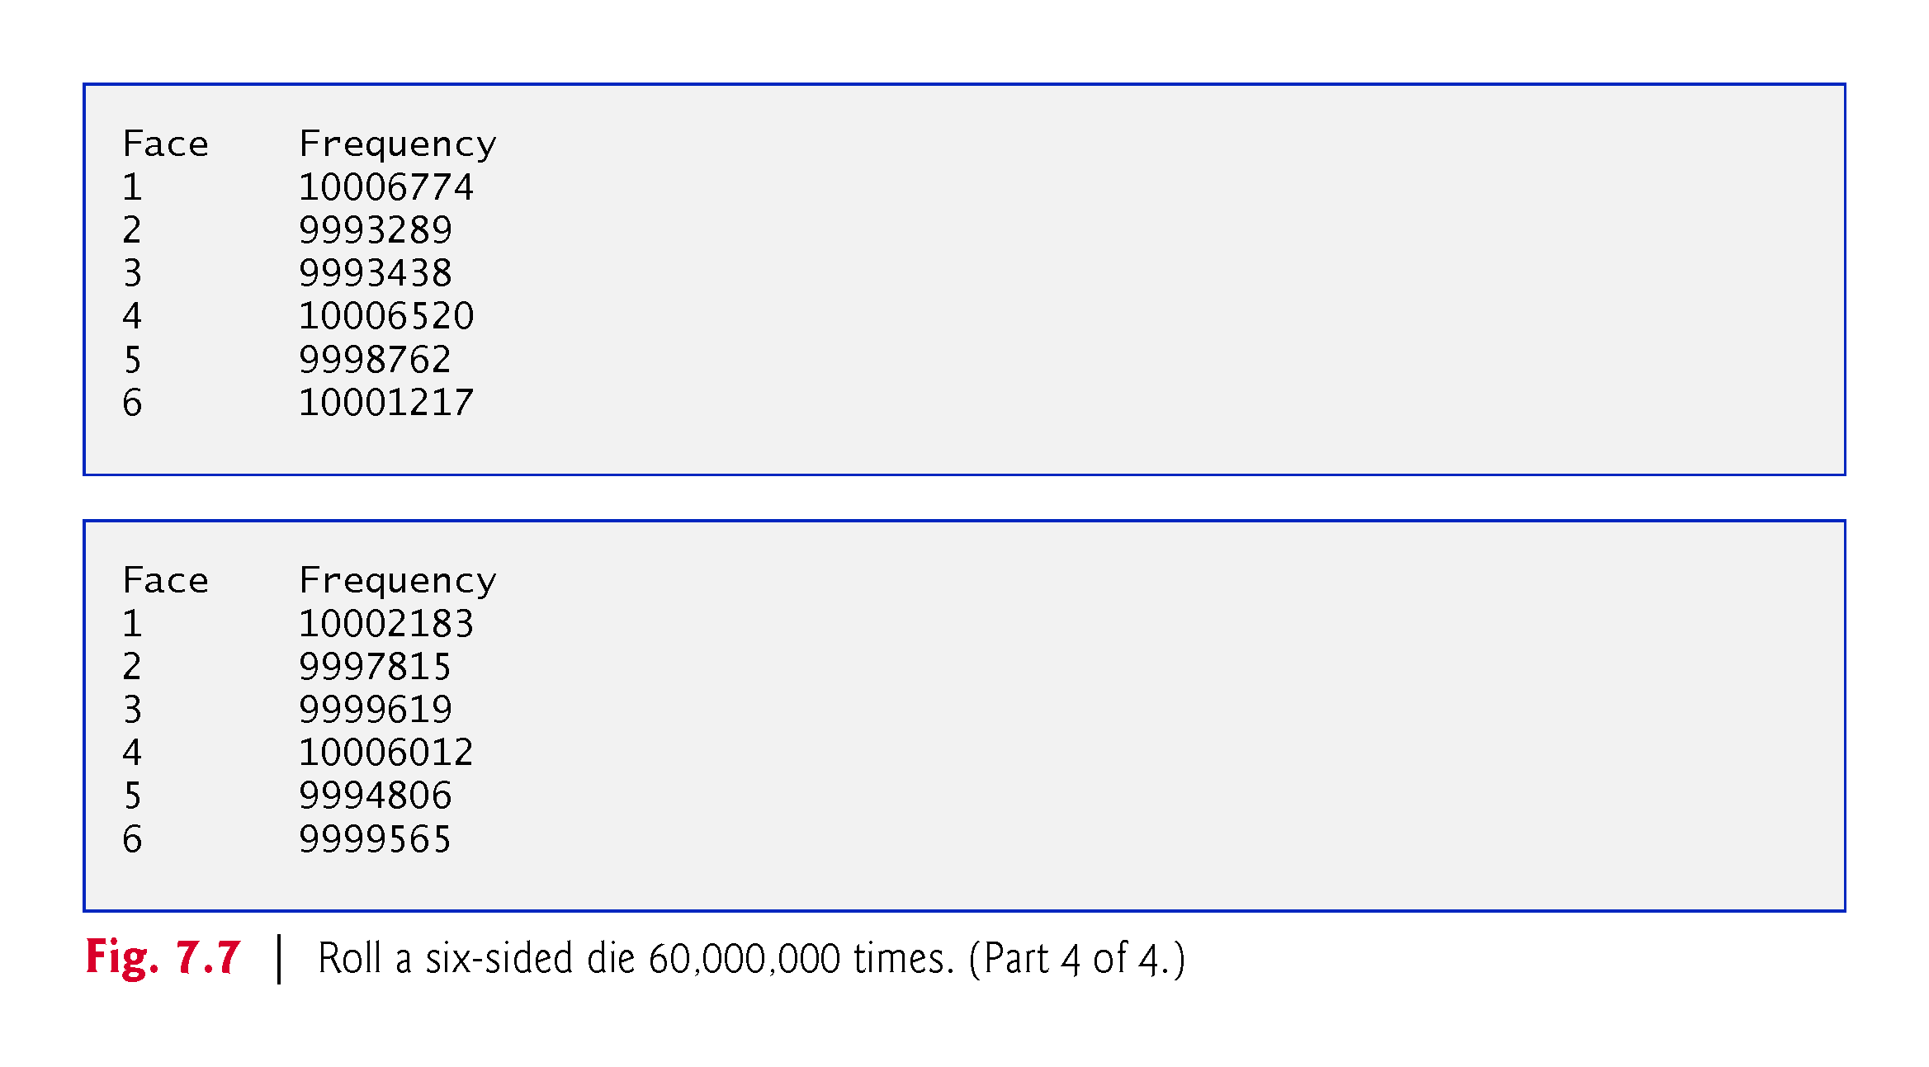

Slide 74
7.8.7 Scaling and Shifting Random Numbers
Given two arguments, the next method allows scaling and shifting as follows:
int number = randomNumbers.Next( shiftingValue, shiftingValue + scalingFactor);
shiftingValue specifies the first number in the desired range of consecutive integers.
scalingFactor specifies how many numbers are in the range.

Slide 75
7.8.7 Scaling and Shifting Random Numbers
To choose integers at random from sets of values other than ranges of consecutive integers, it is simpler to use the version of the Next method that takes only one argument:
int number = shiftingValue + differenceBetweenValues * randomNumbers.Next(scalingFactor);
shiftingValue specifies the first number in the desired range of values.
differenceBetweenValues represents the difference between consecutive numbers in the sequence.
scalingFactor specifies how many numbers are in the range.

Slide 76
7.8.8 Repeatability for Testing and Debugging
The calculation that produces the pseudorandom numbers uses the time of day as a seed value to change the sequence’s starting point.
You can pass a seed value to the Random object’s constructor.
Given the same seed value, the Random object will produce the same sequence of random numbers.

Slide 77
7.9 Case Study: A Game of Chance; Introducing Enumerations
The rules of the dice game craps are as follows:
You roll two dice. Each die has six faces, which contain one, two, three, four, five and six spots, respectively. After the dice have come to rest, the sum of the spots on the two upward faces is calculated. If the sum is 7 or 11 on the first throw, you win. If the sum is 2, 3 or 12 on the first throw (called “craps”), you lose (i.e., “the house” wins). If the sum is 4, 5, 6, 8, 9 or 10 on the first throw, that sum becomes your “point.” To win, you must continue rolling the dice until you “make your point” (i.e., roll that same point value). You lose by rolling a 7 before making your point.
The program is shown in Fig. 7.8.

Slide 78
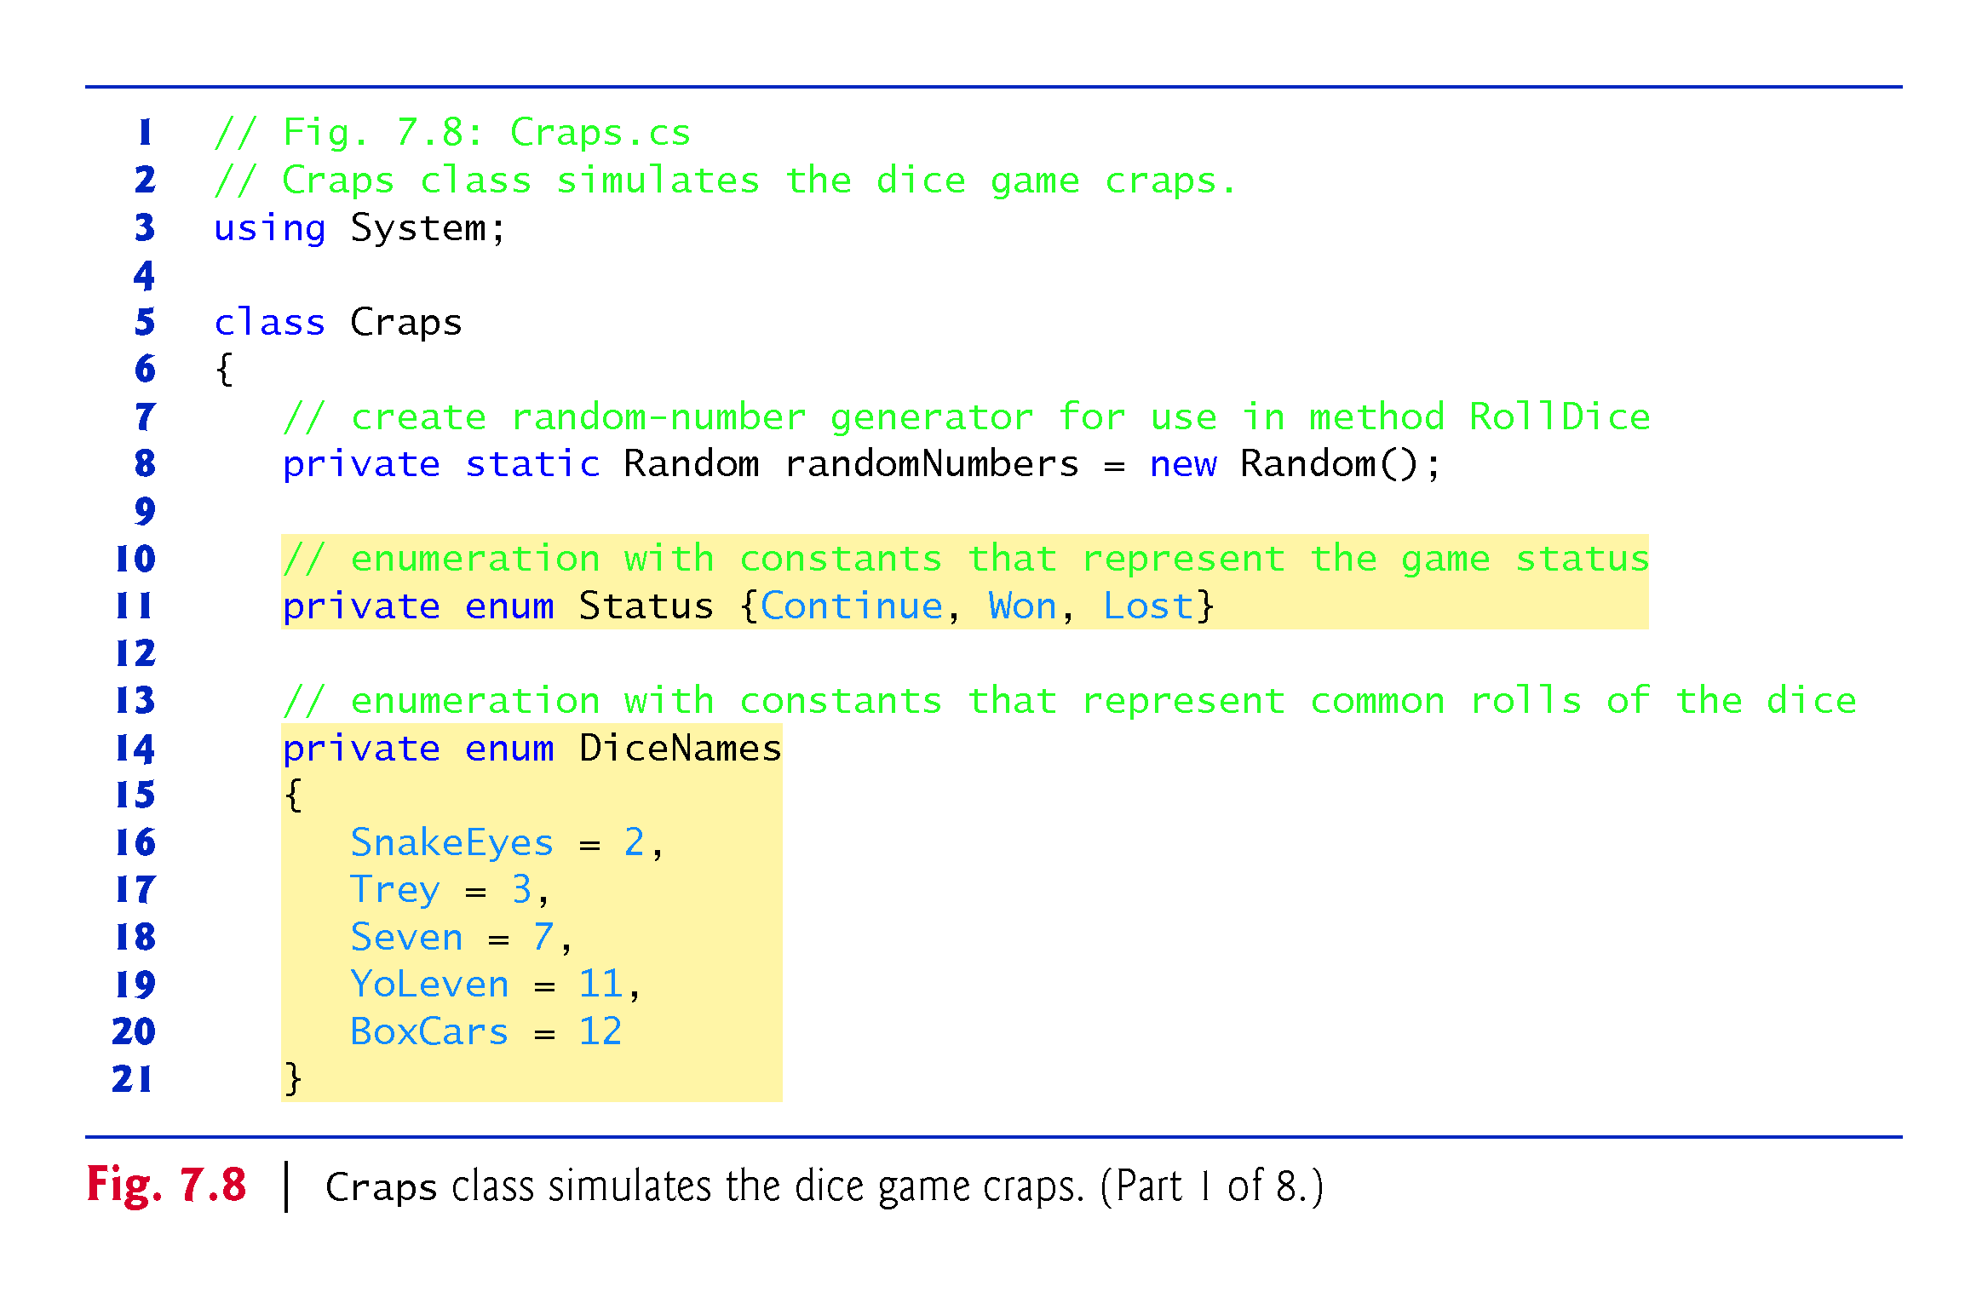

Slide 79
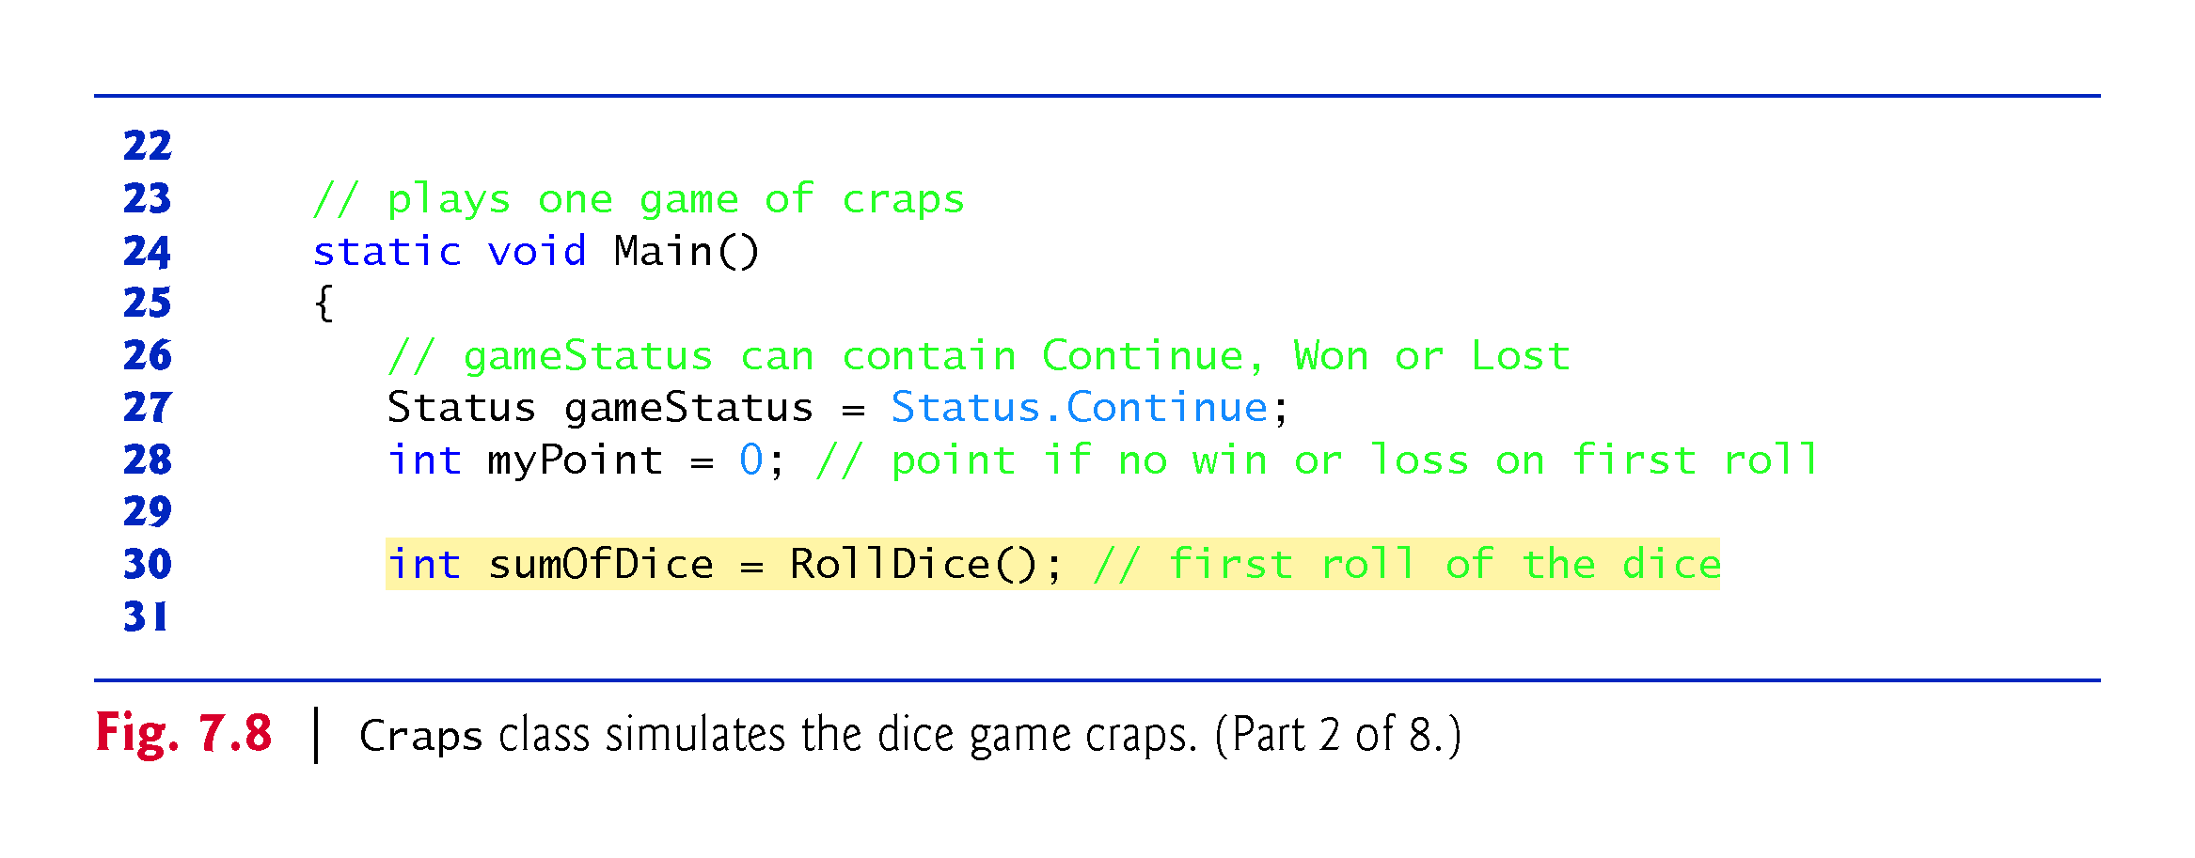

Slide 80
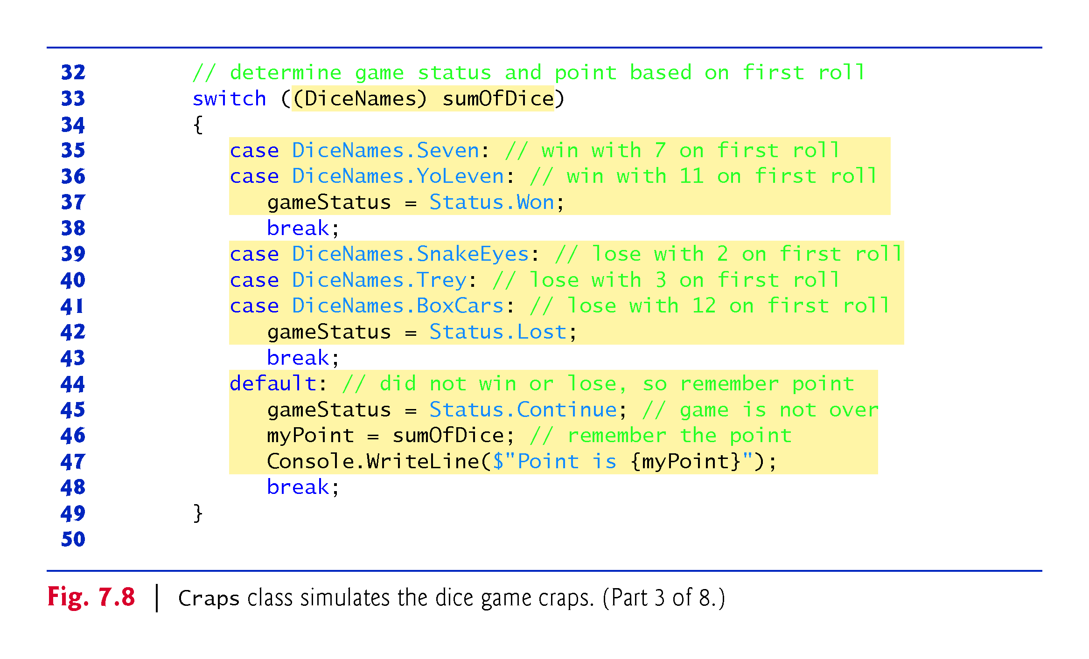

Slide 81
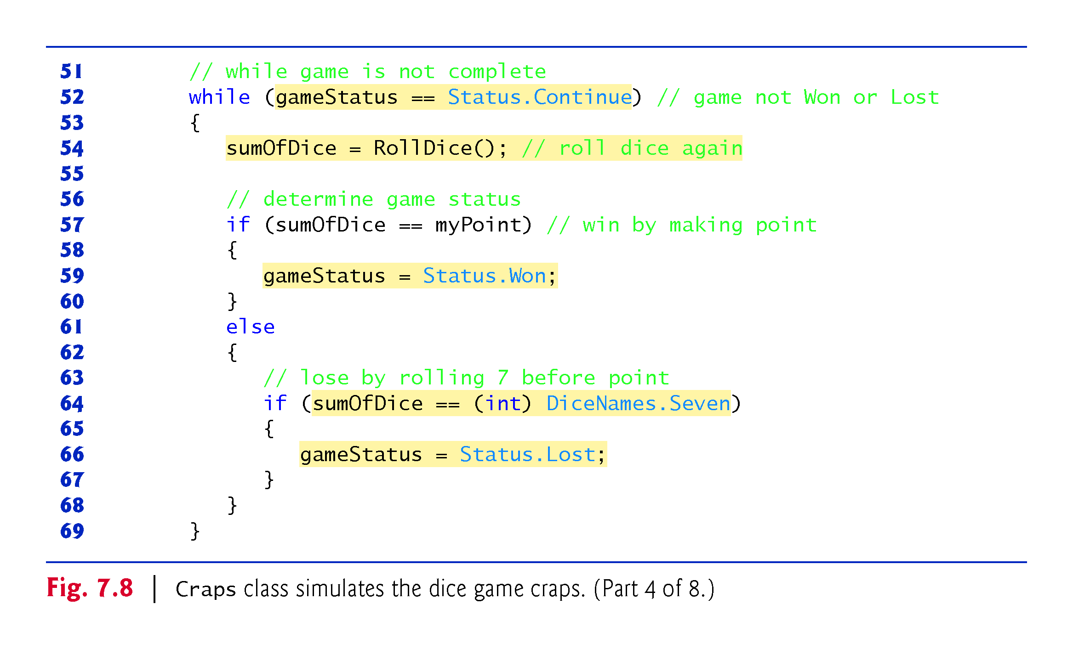

Slide 82
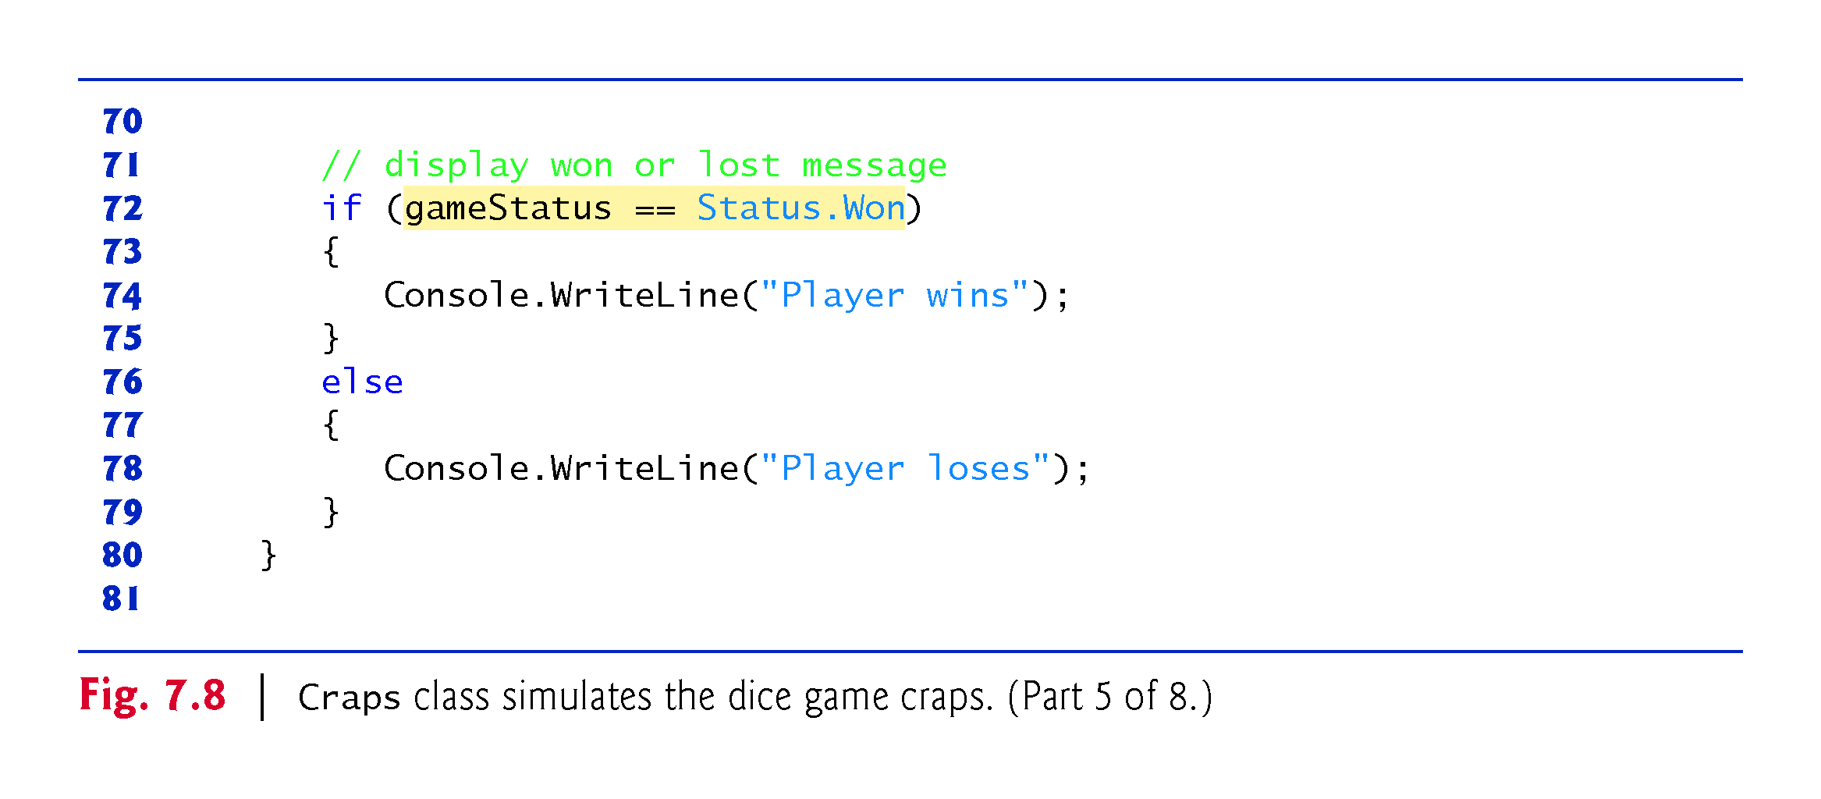

Slide 83
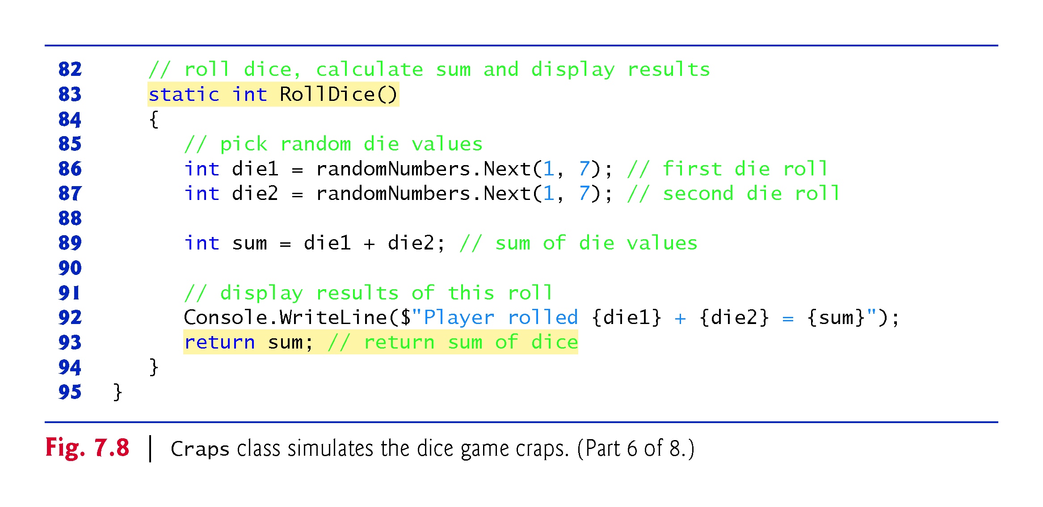

Slide 84
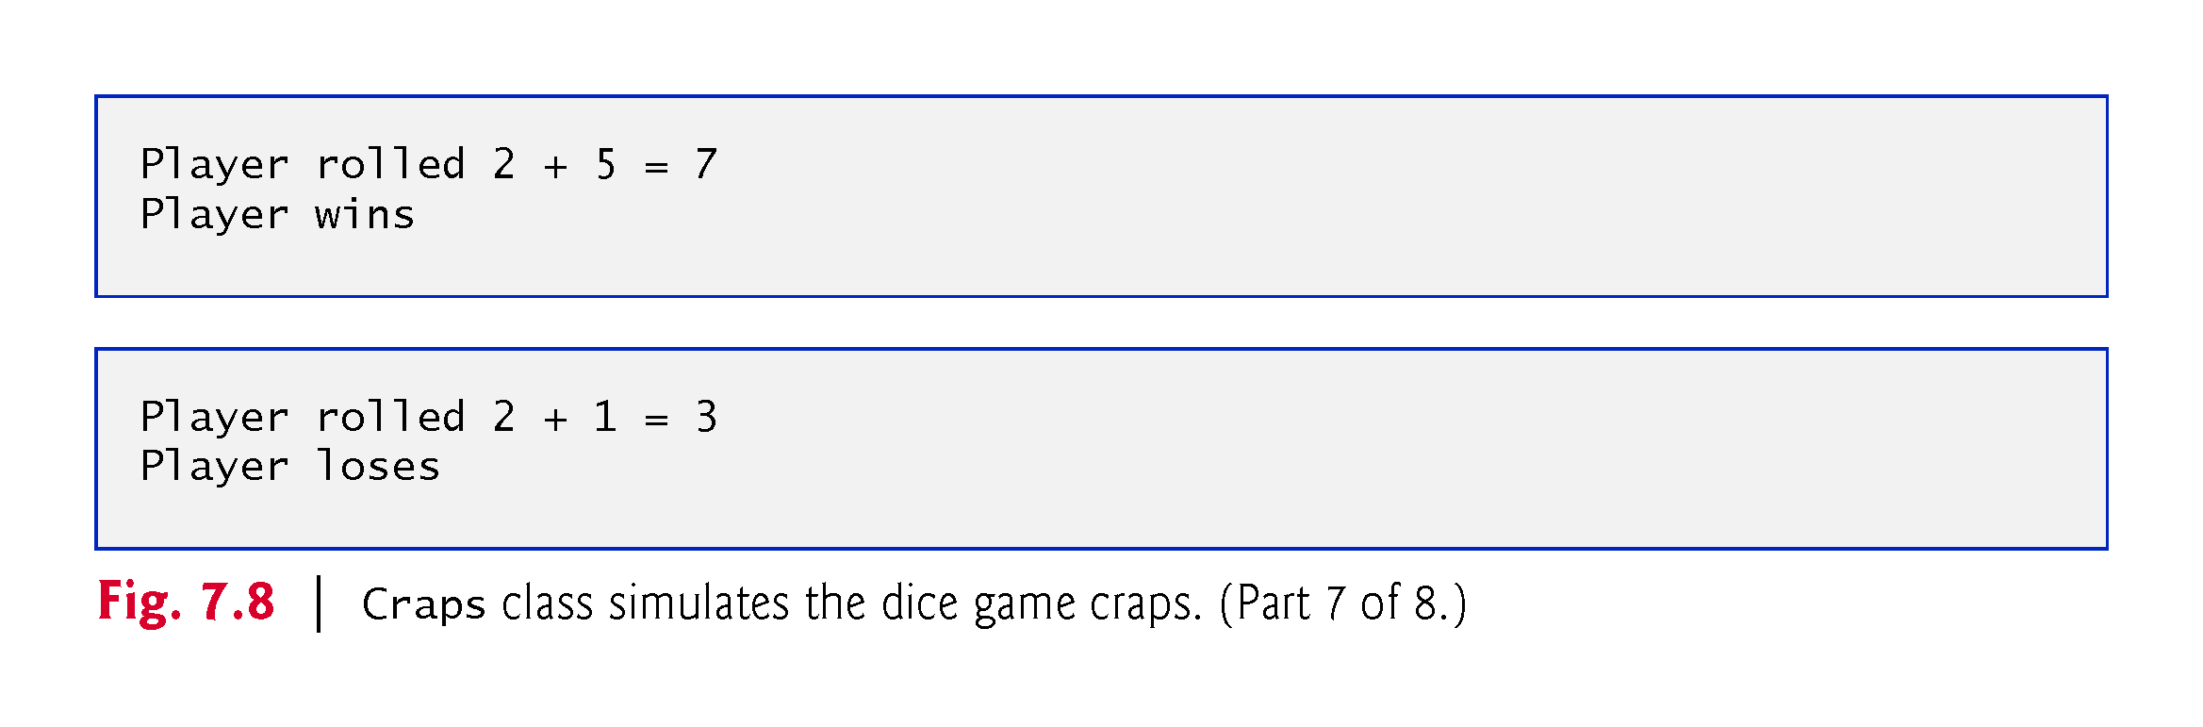

Slide 85
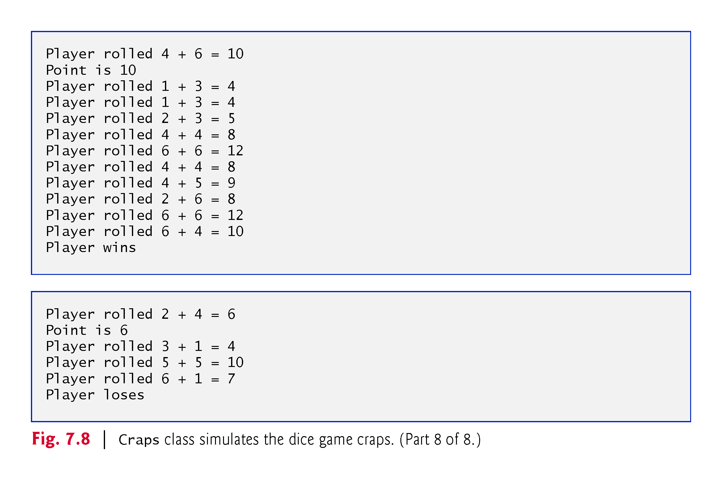

Slide 86
7.9.1 Case Study: A Game of Chance; Introducing Enumerations (Cont.)
A user-defined type called an enumeration declares a set of constants represented by identifiers, and is introduced by the keyword enum and a type name.
As with a class, braces ({ and }) delimit the body of an enum declaration. Inside the braces is a comma-separated list of enumeration constants.
The enum constant names must be unique, but the value associated with each constant need not be.
Variables of an enumeration type should be assigned only the values declared in the enumeration.

Slide 87
7.9 Case Study: A Game of Chance; Introducing Enumerations (Cont.)
When an enum is declared, each constant in the enum declaration is a constant value of type int.
If you do not assign a value to an identifier in the enum declaration, the compiler will do so.
If the first enum constant is unassigned, the compiler gives it the value 0.
If any other enum constant is unassigned, the compiler gives it a value equal to one more than the value of the preceding enum constant.

Slide 88
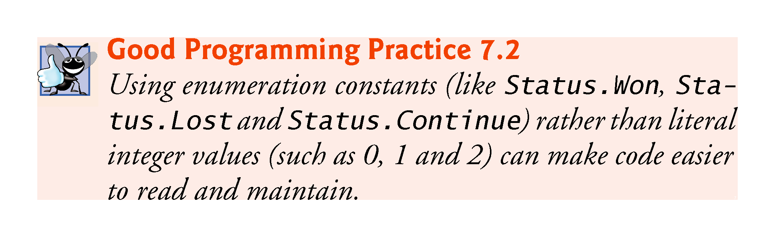

Slide 89
7.9 Case Study: A Game of Chance; Introducing Enumerations (Cont.)
You can declare an enum’s underlying type to be byte, sbyte, short, ushort, int, uint, long or ulong by writing
private enum MyEnum : typeName { Constant1, Constant2, ... }
typeName represents one of the integral simple types.
To compare a simple integral type value to the underlying value of an enumeration constant, you must use a cast operator.

Slide 90
7.10 Scope of Declarations
The scope of a declaration is the portion of the app that can refer to the declared entity by its unqualified name.
The basic scope rules are as follows:
The scope of a parameter declaration is the body of the method in which the declaration appears.
The scope of a local-variable declaration is from the point at which the declaration appears to the end of the block containing the declaration.
The scope of a non-static method, property or field of a class is the entire body of the class.
If a local variable or parameter in a method has the same name as a field, the field is hidden until the block terminates.

Slide 91
7.10 Scope of Declarations
The scope of a declaration is the portion of the app that can refer to the declared entity by its unqualified name.
The basic scope rules are as follows:
The scope of a parameter declaration is the body of the method in which the declaration appears.
The scope of a local-variable declaration is from the point at which the declaration appears to the end of the block containing the declaration.
The scope of a non-static method, property or field of a class is the entire body of the class.
If a local variable or parameter in a method has the same name as a field, the field is hidden until the block terminates.

Slide 92
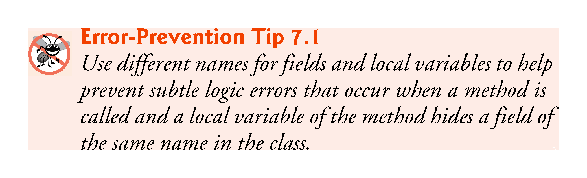

Slide 93
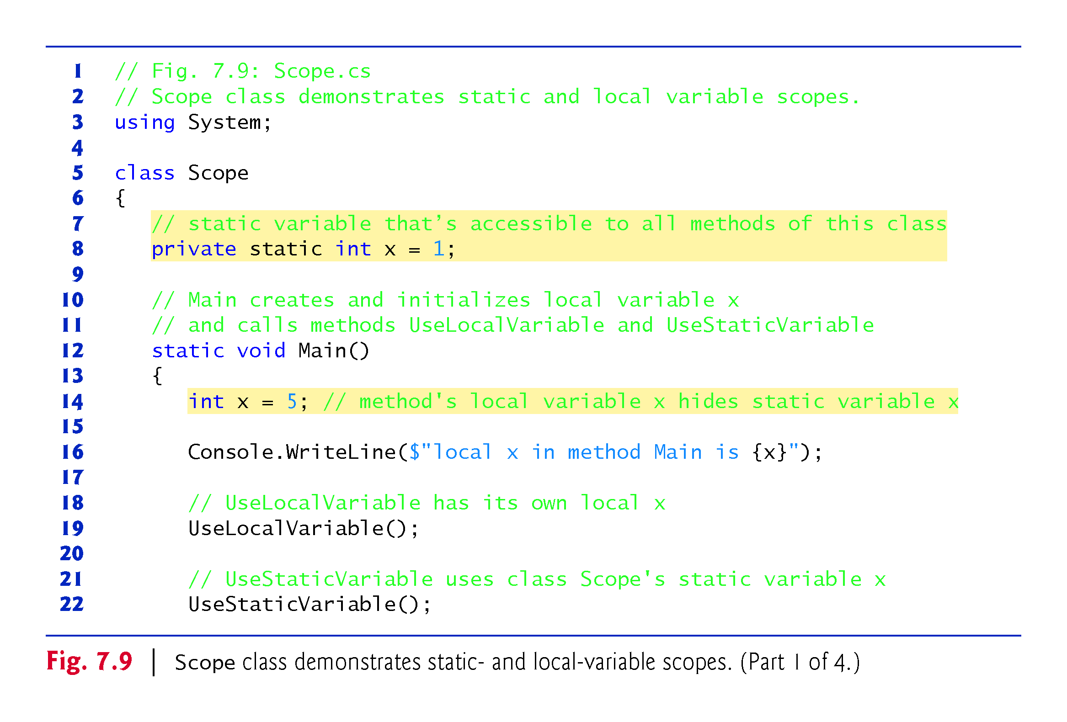

Slide 94
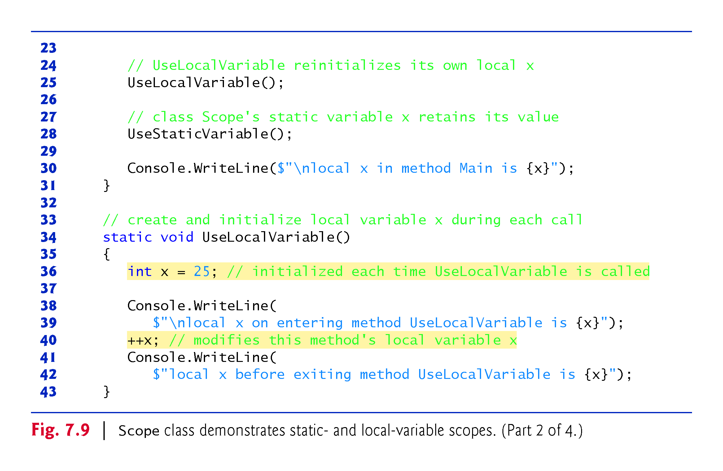

Slide 95
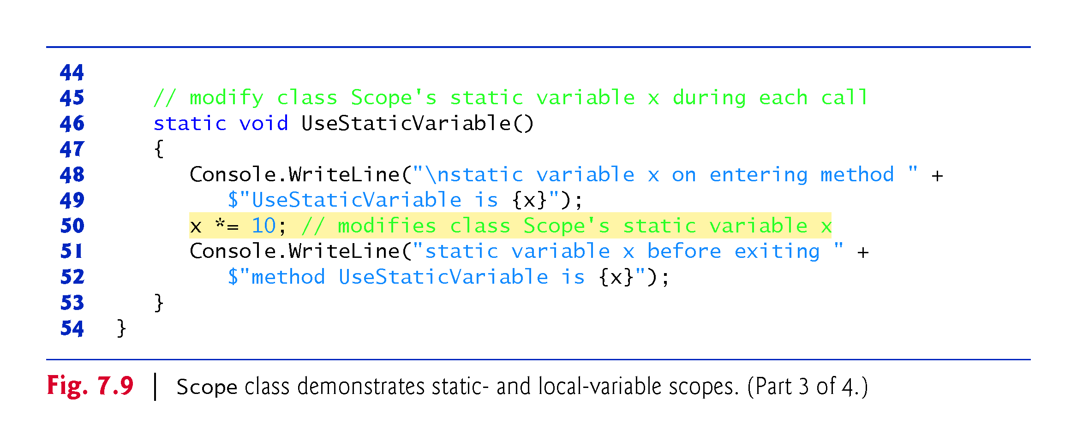

Slide 96
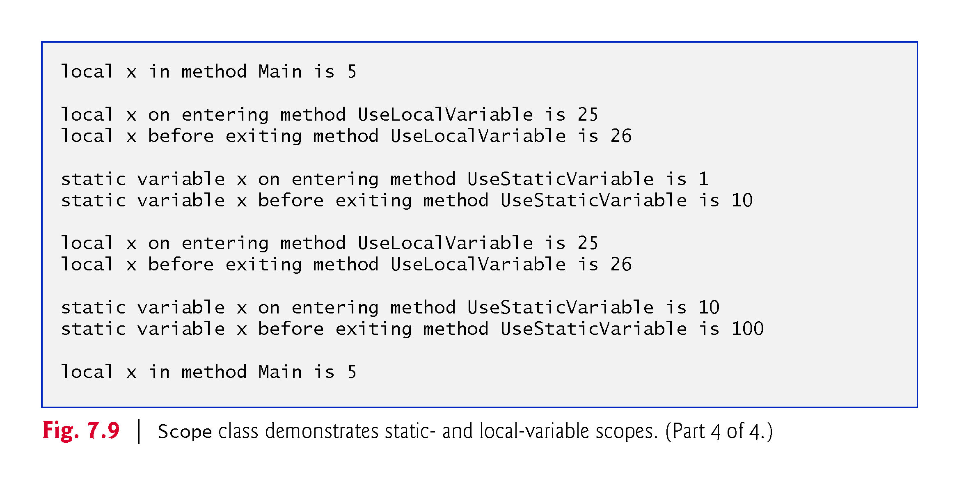

Slide 97
7.11 Method-Call Stack and Activation Records
To understand how C# performs method calls, we first need to consider a data structure (i.e., collection of related data items) known as a stack.
Analogous to a pile of dishes.
When a dish is placed on the pile, it’s placed at the top—referred to as pushing the dish onto the stack.
Similarly, when a dish is removed from the pile, it’s removed from the top—referred to as popping the dish off the stack.
Stacks are known as last-in, first-out (LIFO) data structures—the last item pushed (inserted) on the stack is the first item popped (removed) from the stack.

Slide 98
7.11.1 Method-Call Stack
One of the most important mechanisms for computer science students to understand is the method-call stack (sometimes referred to as the program-execution stack).
This data structure—working “behind the scenes”—supports the method call/return mechanism.
It also supports the creation, maintenance and destruction of each called method’s local variables.
Last-in, first-out (LIFO) behavior is exactly what a method needs in order to return to the method that called it.

Slide 99
7.11.2 Stack Frames
As each method is called, it may, in turn, call other methods, which may, in turn, call other methods—all before any of the methods return.
Each method eventually must return control to the method that called it.
So, somehow, the system must keep track of the return addresses that each method needs in order to return control to the method that called it.
The method--call stack is the perfect data structure for handling this information.

Slide 100
7.11.2 Stack Frames
Each time a method calls another method, an entry is pushed onto the stack.
This entry, called a stack frame or an activation record, contains the return address that the called method needs in order to return to the calling method.
If the called method returns instead of calling another method before returning, the stack frame for the method call is popped, and control transfers to the return address in the popped stack frame.
The same techniques apply when a method accesses a property or when a property calls a method.

Slide 101
7.11.2 Stack Frames
The beauty of the call stack is that each called method always finds the information it needs to return to its caller at the top of the call stack.
If a method makes a call to another method, a stack frame for the new method call is simply pushed onto the call stack.
Thus, the return address required by the newly called method to return to its caller is now located at the top of the stack.

Slide 102
7.11.3 Local Variables and Stack Frames
Most methods have local variables—parameters and any local variables the method declares.
Local variables need to exist while a method is executing.
When a called method returns to its caller, the called method’s local variables need to “go away.”
The called method’s stack frame is a perfect place to reserve the memory for the called method’s local variables.
That stack frame exists as long as the called method is active.
When that method returns—and no longer needs its local variables—its stack frame is popped from the stack, and those local variables no longer exist.

Slide 103
7.11.4 Stack Overflow
The amount of memory in a computer is finite, so only a certain amount of memory can be used to store activation records on the method-call stack.
If more method calls occur than can have their activation records stored on the method-call stack, a fatal error known as stack overflow occurs—typically caused by infinite recursion.
[This is how the website stackoverflow.com got its name. This is a great website for getting answers to your programming questions.]

Slide 104
7.11.5 Method-Call Stack in Action
Now let’s consider how the call stack supports the operation of a Square method (lines 15–18 of Fig. 7.10) called by Main (lines 8–12).

Slide 105
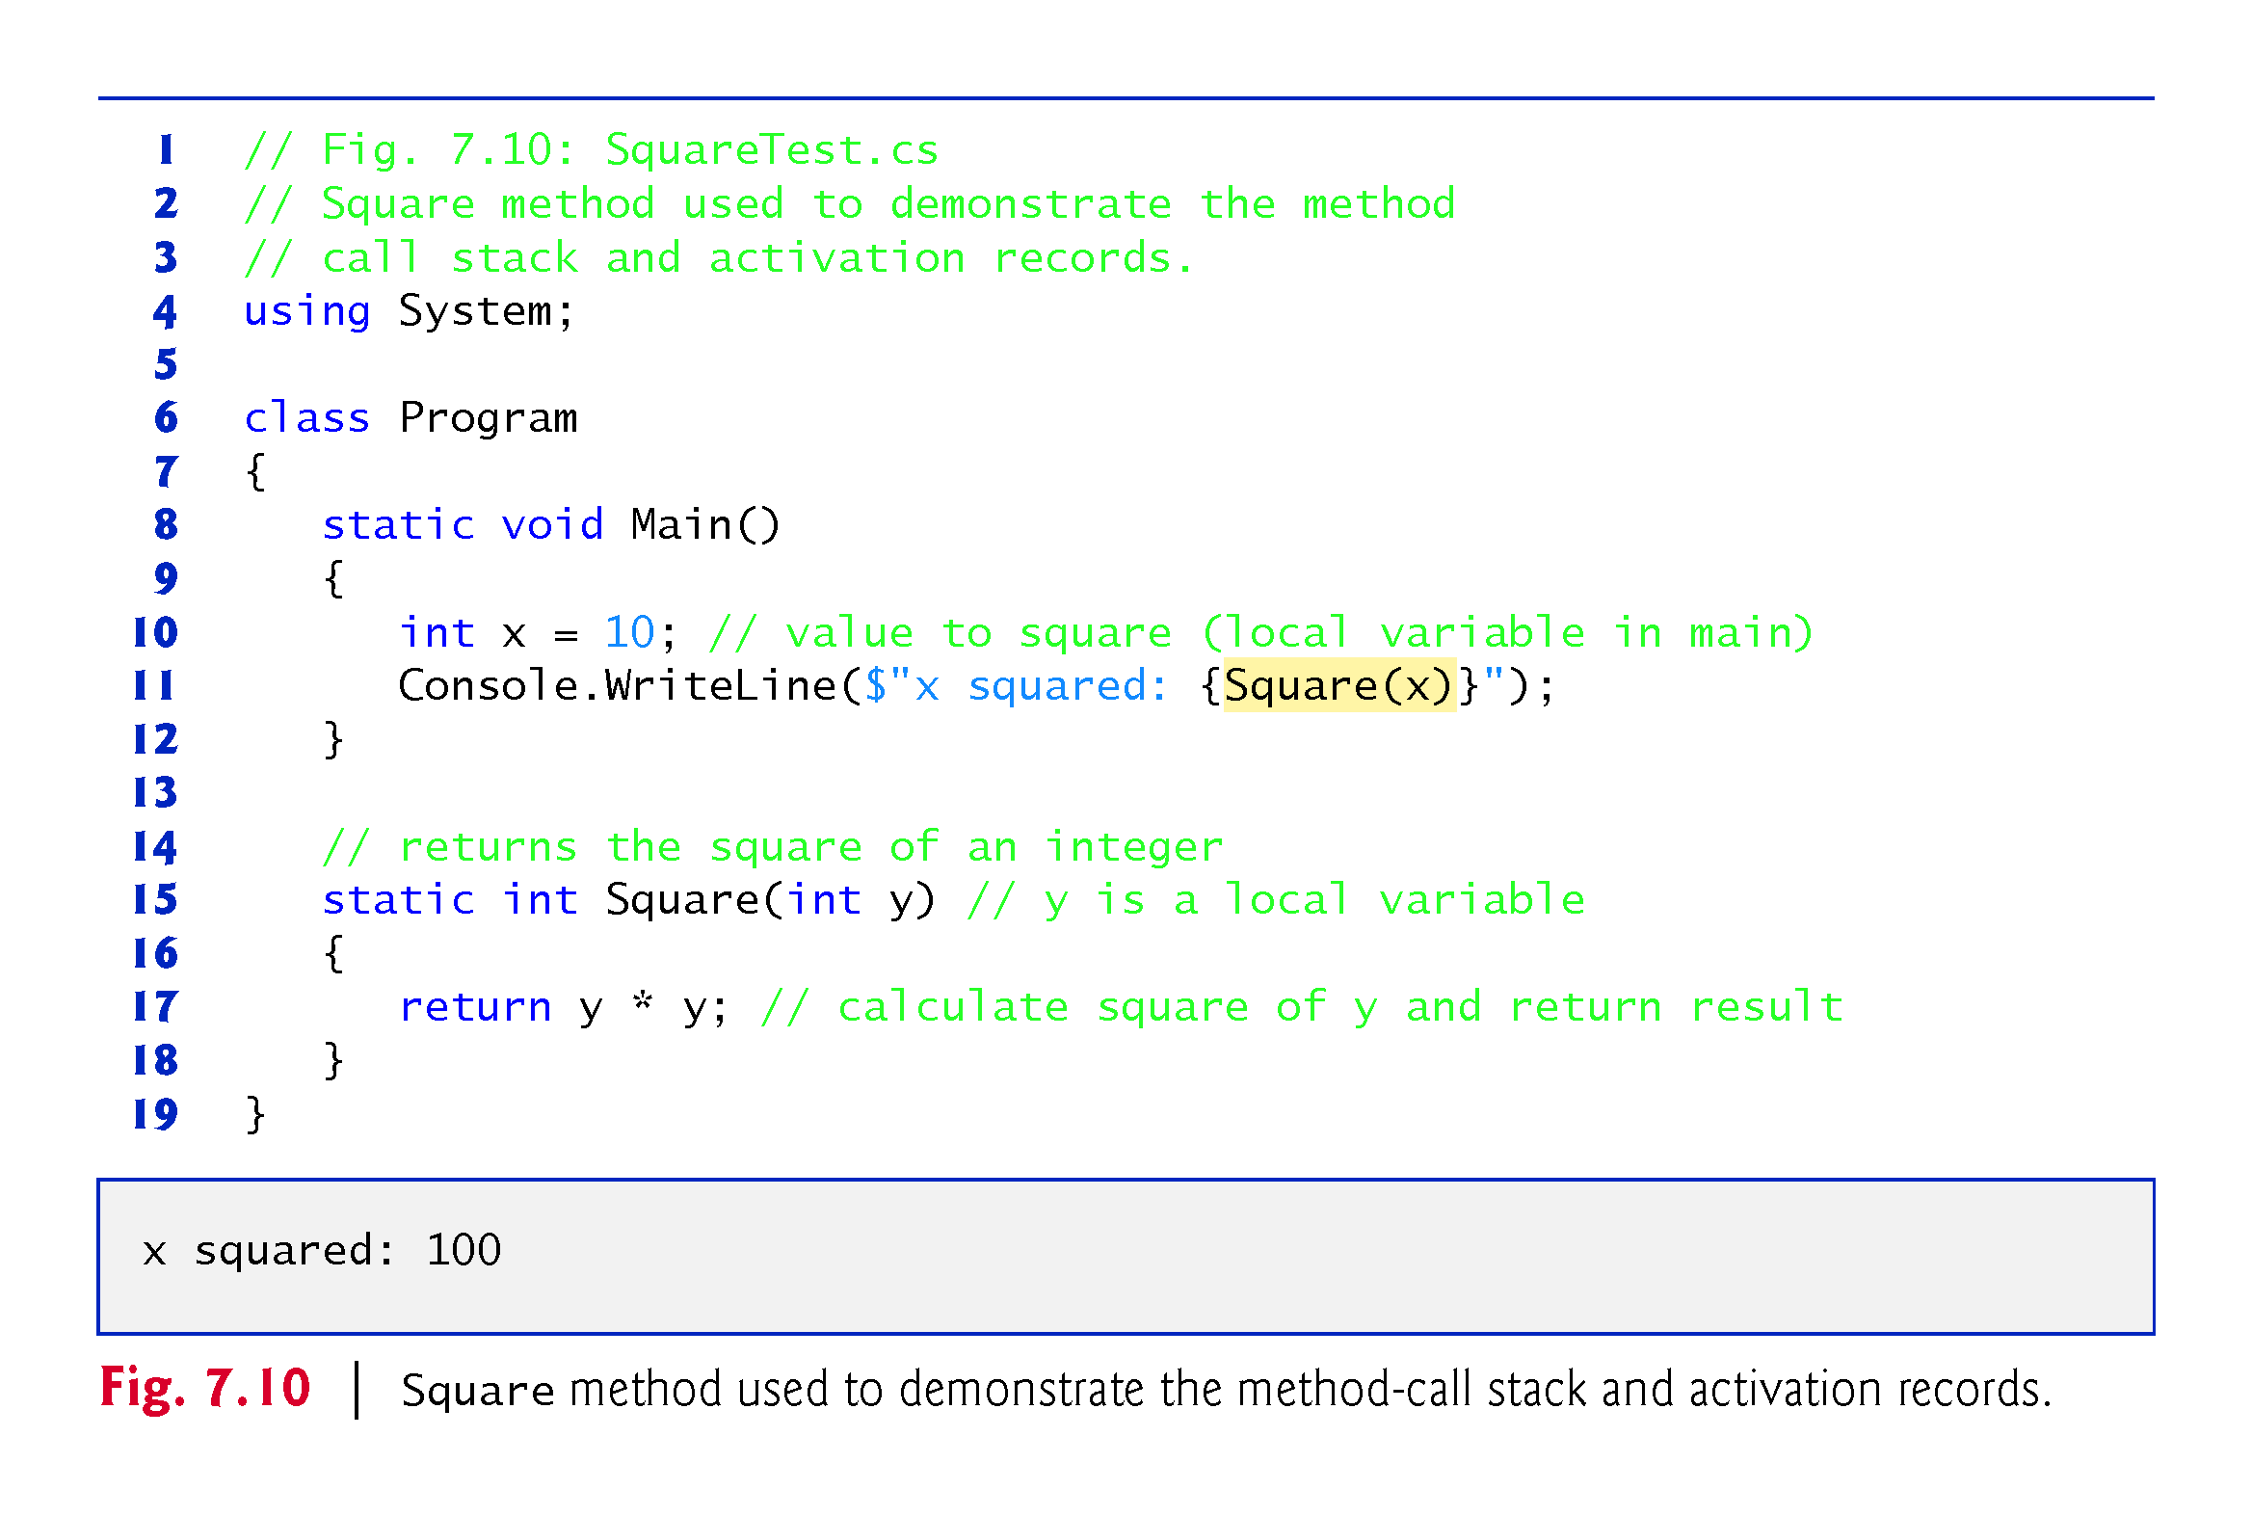

Slide 106
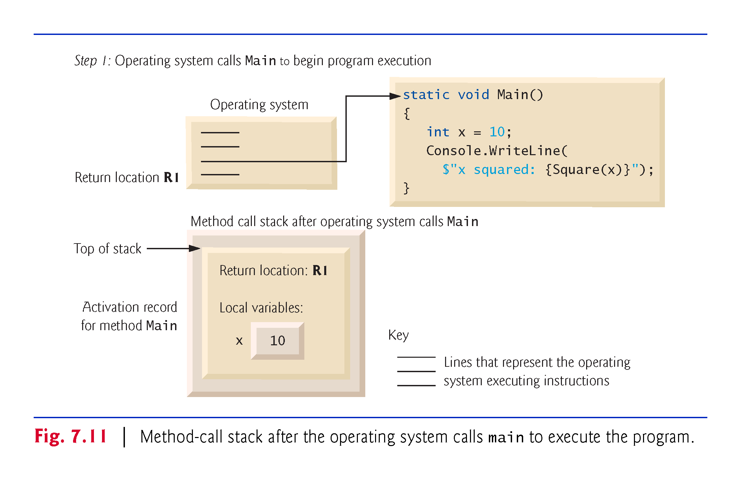

Slide 107


Slide 108


Slide 109
7.12 Method Overloading
Methods of the same name can be declared in the same class, or overloaded, as long as they have different sets of parameters.
When an overloaded method is called, the C# compiler selects the appropriate method by examining the number, types and order of the arguments in the call.
Method overloading is used to create several methods with the same name that perform the same tasks, but on different types or numbers of arguments.

Slide 110
7.12.1 Declaring Overloaded Methods
Class MethodOverload (Fig. 7.10) includes two overloaded versions of a method called Square.
Although these methods have the same name and similar parameter lists and bodies, you can think of them simply as different methods.
It may help to think of the method names as “Square of int” and “Square of double,” respectively

Slide 111


Slide 112


Slide 113
7.12.2 Distinguishing Between Overloaded Methods
The compiler distinguishes overloaded methods by their signature—a combination of the method’s name and the number, types and order of its parameters.

Slide 114
7.12.3 Return Types of Overloaded Methods
Method calls cannot be distinguished by return type.
If in a class you define overloaded methods with the following headers:
int Square(int x)
double Square(int x)
The compiler generates the following error for the second Square method:
Type 'MethodOverloadError' already defines a member called 'Square' with the same parameter types
Overloaded methods can have the same or different return types if the parameter lists are different. Also, overloaded methods need not have the same number of parameters

Slide 115


Slide 116
7.13 Optional Parameters
Methods can have optional parameters that allow the calling method to vary the number of arguments to pass.
An optional parameter specifies a default value that’s assigned to the parameter if the optional argument is omitted.
You can create methods with one or more optional parameters.
All optional parameters must be placed to the right of the method’s non-optional parameters.

Slide 117


Slide 118
7.13 Optional Parameters (Cont.)
When a parameter has a default value, the caller has the option of passing that particular argument.
For example, the method header
static int Power(int baseValue, int exponentValue = 2)
specifies an optional second parameter.
Any call to Power must pass at least an argument for the parameter baseValue, or a compilation error occurs.

Slide 119
7.13 Optional Parameters (Cont.)
Optionally, a second argument (for the exponentValue parameter) can be passed to Power. Consider the following calls to Power:
Power()
Power(10)
Power(10, 3)
The first generates a compilation error because this method requires a minimum of one argument.
The second is valid because one argument (10) is being passed—the optional exponentValue is not specified in the method call.
The last call is also valid—10 is passed as the required argument and 3 is passed as the optional argument.

Slide 120
7.13 Optional Parameters (Cont.)
In the call that passes only one argument (10), parameter exponentValue defaults to 2, which is the default value specified in the method’s header.
Each optional parameter must specify a default value by using an equal (=) sign followed by the value.
Figure 7.15 demonstrates an optional parameter. The program calculates the result of raising a base value to an exponent.

Slide 121


Slide 122


Slide 123
7.14 Named Parameters
C# provides a feature called named parameters, which enable you to call methods that receive optional parameters by providing only the optional arguments you wish to specify.
Explicitly specify the parameter’s name and value—separated by a colon (:)—in the argument list of the method call.
For example:
// sets the time to 12:00:22
t.SetTime( hour: 12, second: 22 );

Slide 124
7.14 Named Parameters
The compiler assigns parameter hour the argument 12 and parameter second the argument 22.
The parameter minute is not specified, so the compiler assigns it the default value 0.
It’s also possible to specify the arguments out of order when using named parameters. The arguments for the required parameters must always be supplied.

Slide 125
7.15 C# 6 Expression Bodied Methods
C# 6 introduces a new concise syntax for:
methods that contain only a return statement that returns a value
read-only properties in which the get accessor contains only a return statement
methods that contain single statement bodies.

Slide 126
7.15 C# 6 Expression Bodied Methods
Consider the following Cube method:
static int Cube(int x) { return x * x * x; }
In C# 6, this can be expressed with an expression-bodied method as
static int Cube(int x) => x * x * x;
The value of x * x * x is returned to Cube’s caller implicitly.
The symbol => follows the method’s parameter list and introduces the method’s body—no braces or return statement are required and this can be used with static and non-static methods alike.

Slide 127
7.15 C# 6 Expression Bodied Methods
If the expression to the right of => does not have a value (e.g., a call to a method that returns void), the expression-bodied method must return void.
Similarly, a read-only property can be implemented as an expression-bodied property.
The following reimplements the IsNoFaultState property in Fig. 6.11 to return the result of a logical expression:
public bool IsNoFaultState => State == "MA" || State == "NJ" || State == "NY" || State == "PA";

Slide 128
7.16 Recursion
A recursive method is a method that calls itself.
A recursive method is capable of solving only the base case(s).
Each method call divides the problem into two conceptual pieces: a piece that the method knows how to do and a recursive call, or recursion step that solves a smaller problem.
A sequence of returns ensues until the original method call returns the result to the caller.

Slide 129
7.16.2 Recursive Factorial Calculations
A recursive declaration of the factorial method is arrived at by observing the following relationship:
n! = n . (n – 1)!
Figure 7.16 shows the values returned from each recursive call in 5! to its caller until the value is calculated and returned.

Slide 130


Slide 131
7.16.2 Recursive Factorial Calculations
Figure 7.14 uses recursion to calculate and display the factorials of the integers from 0 to 10.

Slide 132


Slide 133


Slide 134


Slide 135
7.16 Recursion (Cont.)
First, test to determine whether the terminating condition is true.
The recursive call solves a slightly simpler problem than the original calculation.

Slide 136


Slide 137
7.17 Value Types vs. Reference Types
Types in C# are divided into two categories—value types and reference types.
C#’s simple types (like int, double and decimal) are all value types.
A variable of a value type simply contains a value of that type.
Fig. 7.18 shows an int variable named count that contains the value 7.

Slide 138


Slide 139
7.17 Value Types vs. Reference Types
A variable of a reference type (also called a reference) contains the location where the data referred to by that variable is stored.
Such a variable is said to refer to an object in the program. For example, the statement
Account myAccount = new Account();
creates an object of our class Account (presented in Chapter 4), places it in memory and stores the object’s reference in variable myAccount of type Account (Fig. 7.19).

Slide 140
7.17 Value Types vs. Reference Types
Reference-type instance variables are initialized by default to null.
A string variable with the value null is not an empty string, which is represented by "" or string.Empty.
The value null represents a reference that does not refer to an object, whereas the empty string is a string object that does not contain any characters.

Slide 141


Slide 142


Slide 143
7.18 Passing Arguments: Pass-by-Value vs. Pass-by-Reference
Two ways to pass arguments to functions in many programming languages are pass-by-value and pass-by-reference.
When an argument is passed by value (the default in C#), a copy of its value is made and passed to the called function.
When an argument is passed by reference, the caller gives the method the ability to access and modify the caller’s original variable.

Slide 144
7.18 Passing Arguments: Pass-by-Value vs. Pass-by-Reference (Cont.)
To pass an object by reference into a method, simply provide as an argument in the method call the variable that refers to the object.
In the method body, the parameter will refer to the original object in memory, so the called method can access the original object directly.
Passing a value-type variable to a method passes a copy of the value.

Slide 145
7.18 Passing Arguments: Pass-by-Value vs. Pass-by-Reference (Cont.)
Passing a reference-type variable passes the method a copy of the actual reference that refers to the object.
The reference itself is passed by value, but the method can still use the reference it receives to modify the original object in memory.
A return statement returns a copy of the value stored in a value-type variable or a copy of the reference stored in a reference-type variable.
In effect, objects are always passed by reference.

Slide 146


Slide 147


Slide 148


Slide 149
7.18.1 ref and out Parameters
Applying the ref keyword to a parameter declaration allows you to pass a variable to a method by reference
The ref keyword is used for variables that already have been initialized in the calling method.
Preceding a parameter with keyword out creates an output parameter.
This indicates to the compiler that the argument will be passed by reference and that the called method will assign a value to it.
A method can return multiple output parameters.

Slide 150


Slide 151


Slide 152


Slide 153


Slide 154
7.18.2 Demonstrating ref, out and Value Parameters
The app in Fig.7.20 uses the ref and out keywords to manipulate integer values.
The class contains three methods that calculate the square of an integer.

Slide 155


Slide 156


Slide 157


Slide 158


Slide 159
7.18.2 Demonstrating ref, out and Value Parameters
When you pass a variable to a method with a reference parameter, you must precede the argument with the same keyword (ref or out) that was used to declare the reference parameter.

Slide 160


